Slide 1
Biostatistics Refresher
Douglas Whitaker, Ph.D.
Mount Saint Vincent University
ISANS IPG/IMG Bridging
27 April 2022

Slide 2
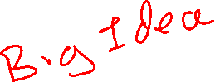
Topics
Core Ideas: Prevalence & Incidence
Types of Studies
Measures of Risk
Statistical Inference
Measures for Screening and Diagnostic Tests

Slide 3
Notes
Biostatistics & Epidemiology are big topics
The measures and approaches discussed here are the core ideas
Many studies use more sophisticated techniques and/or adjustments
Trying to reproduce results from a paper?
Sophisticated techniques or adjustments might prevent this
Rounding might make numbers ‘a little’ off
Proportions vs. Percentages
Proportions are more suitable for calculations; between 0 and 1
Percentages are often reported; between 0% and 100%

Slide 4
Core Ideas
Definitions

Slide 5
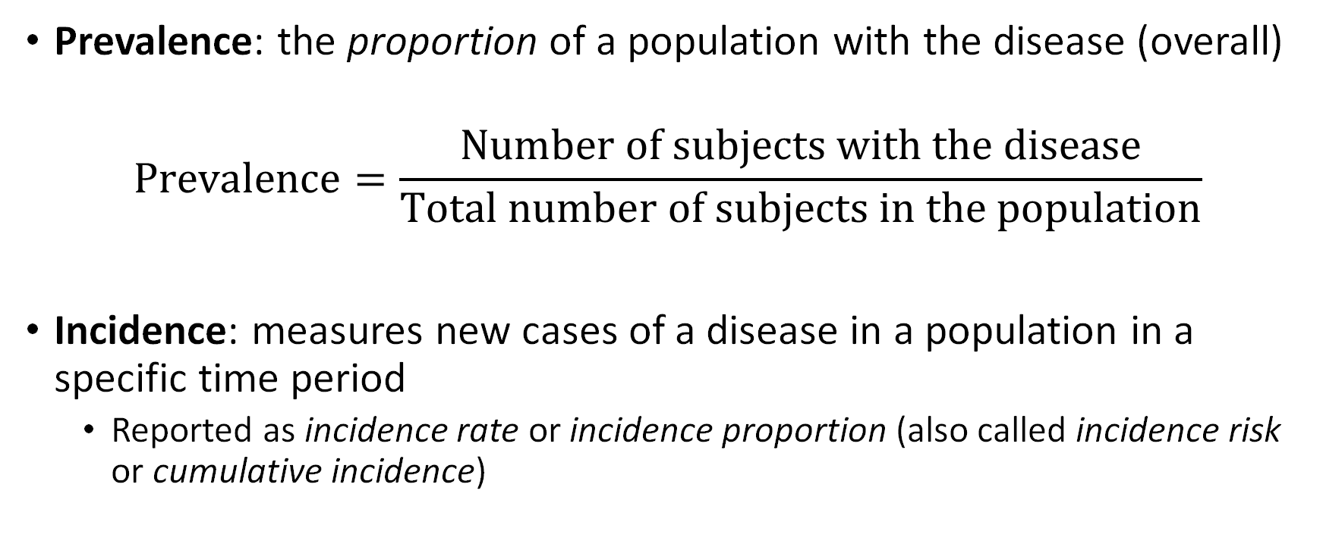
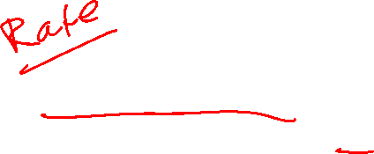
Incidence and Prevalence
Prevalence: the proportion of a population with the disease (overall)
$$Prevalence=\frac{Number of subjects with the disease}{Total number of subjects in the population}$$
Incidence: measures new cases of a disease in a population in a specific time period
Reported as incidence rate or incidence proportion (also called incidence risk or cumulative incidence)
Notes:
https://www.nimh.nih.gov/health/statistics/what-is-prevalence.shtml
Emphasize RATE for incidence

Slide 6
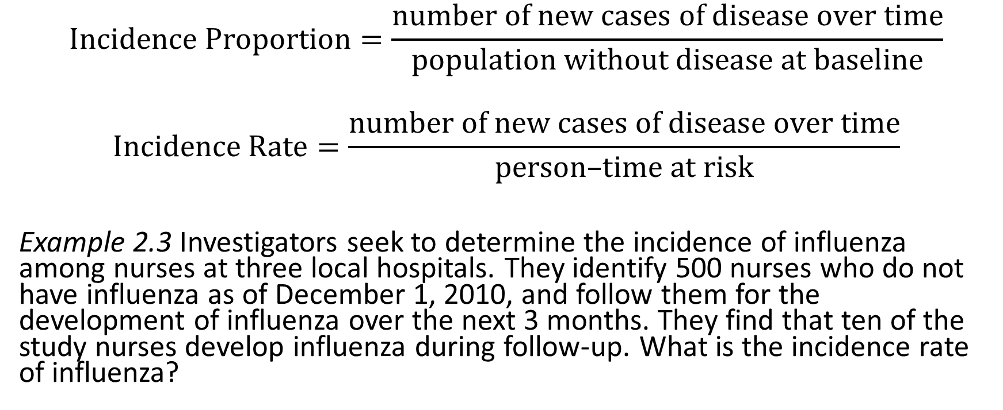
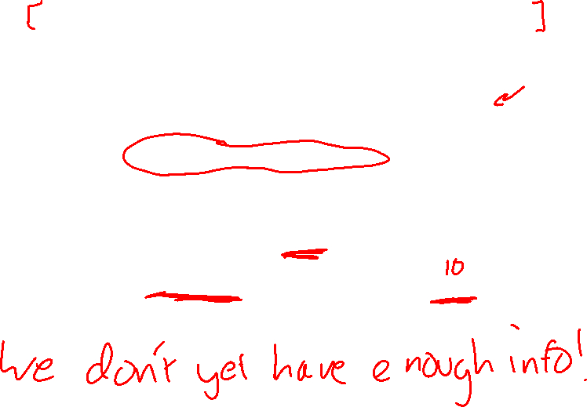
Incidence
$$Incidence Proportion=\frac{number of new cases of disease over time}{population without disease at baseline}$$
$$Incidence Rate=\frac{number of new cases of disease over time}{\text{person}\text{–}\text{time} at risk}$$
Example 2.3 Investigators seek to determine the incidence of influenza among nurses at three local hospitals. They identify 500 nurses who do not have influenza as of December 1, 2010, and follow them for the development of influenza over the next 3 months. They find that ten of the study nurses develop influenza during follow-up. What is the incidence rate of influenza?
Example 2.3 from Kestenbaum B. Epidemiology and Biostatistics: An Introduction to Clinical Research. Second edition. (Weiss NS, Shoben A, eds.). Cham: Springer; 2019.
Notes:
This closely follows Kestenbaum et al. 2019
Not enough information to answer this yet!

Slide 7
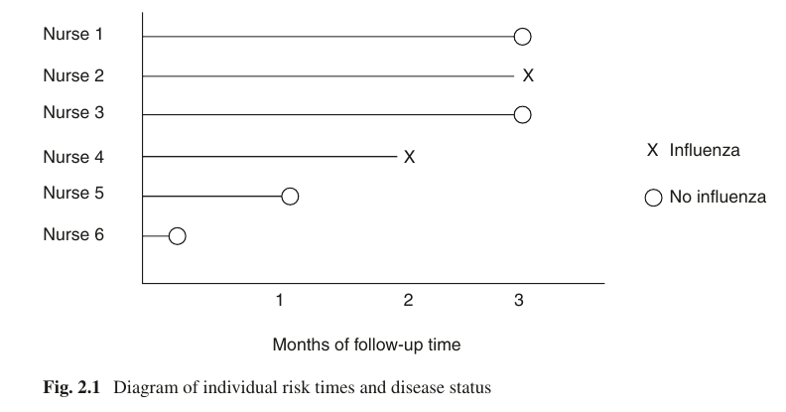
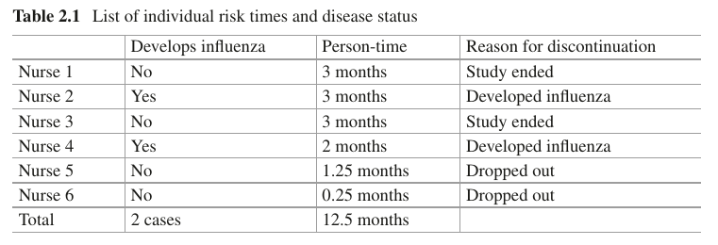
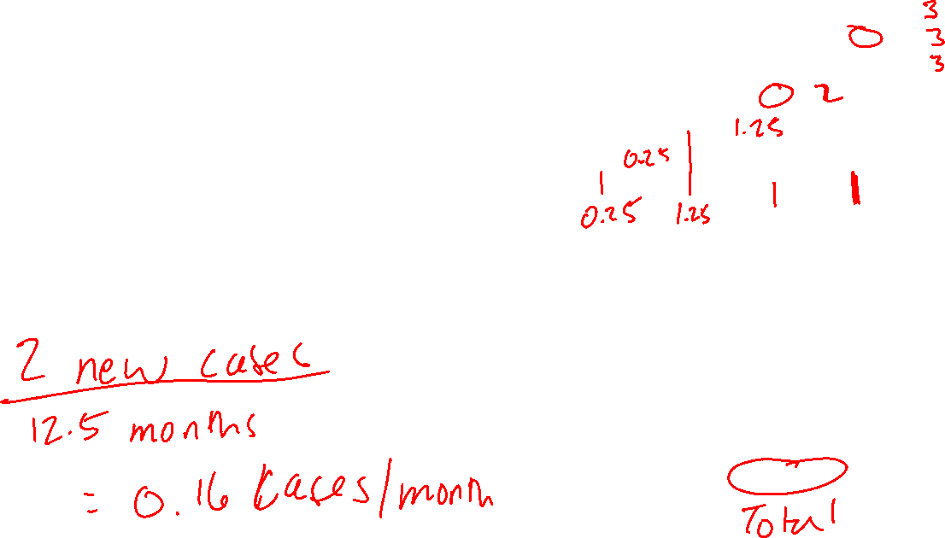
Incidence
Detour: Instead of all 500 nurses, consider these 6.
What is the incidence rate for these 6 individuals?
C
Example 2.3 from Kestenbaum B. Epidemiology and Biostatistics: An Introduction to Clinical Research. Second edition. (Weiss NS, Shoben A, eds.). Cham: Springer; 2019.
Notes:
This closely follows Kestenbaum et al. 2019
$$\frac{2 new cases}{12.5 months}=0.16 cases/month$$

Slide 8
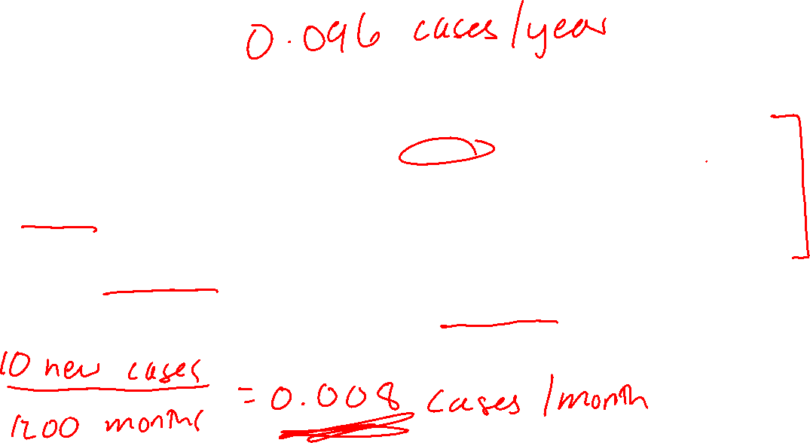
Incidence
Example 2.3 Investigators seek to determine the incidence of influenza among nurses at three local hospitals. They identify 500 nurses who do not have influenza as of December 1, 2010, and follow them for the development of influenza over the next 3 months. They find that ten of the study nurses develop influenza during follow-up.
What is the incidence rate of influenza?
Need to know person-time at risk. Suppose it is 1200 months.
Example 2.3 from Kestenbaum B. Epidemiology and Biostatistics: An Introduction to Clinical Research. Second edition. (Weiss NS, Shoben A, eds.). Cham: Springer; 2019.
Notes:
$$\frac{10 new cases}{1200 months}=0.008 cases/month$$

Slide 9
Incidence
Incidence proportions: more interpretable
Incidence rates: used for comparisons of disease among different groups
Incidence rate is often multiplied by a factor (e.g., 10 or 1000) to make it more easily interpretable.

Slide 10
Morbidity and Mortality
Morbidity refers to illness – not death
Mortality refers to death
Prevalence measures morbidity in a population
Mortality rate measures deaths in the population
Notes:
https://www.health.ny.gov/diseases/chronic/basicstat.htm
Prevalence – snapshot of disease active in a population

Slide 11
Types of Studies

Slide 12
Types of Studies: Overview
Case Reports
Cross-Sectional Studies
Cohort Studies
Case-Control Studies
Randomized Trials

Slide 13


Types of Studies: Case Reports
Observational study
Describes experiences of individuals with a disease or condition
Good for: new diseases, generating hypotheses, raising awareness
Limitations:
Cannot calculate incidence
No comparison group
Often describe individuals that are not typical
Often small sample sizes – lots of variability
Notes:
Is about individuals ONLY – no ability to make group statements

Slide 14

Types of Studies: Cross-Sectional
Measure the outcome of interest and exposures/factors at the same time from a group of interest.
Notes:
Cross-section
Snapshot
One moment in time
ASSOCIATIONS/PREVALENCE
Limitation: no causation

Slide 15
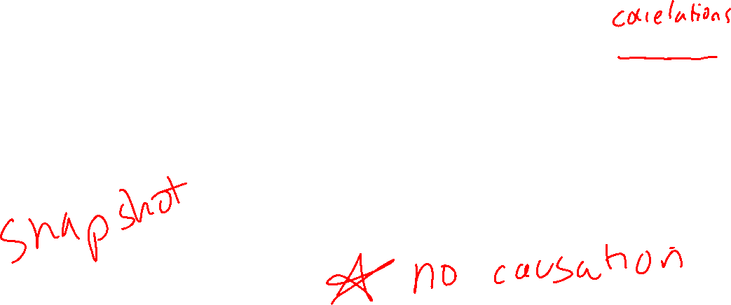
Types of Studies: Cross-Sectional
Measure the outcome of interest and exposures/factors at the same time from a group of interest.
Good for: establishing associations between exposures/factors and disease prevalence
Limitations: cannot establish a temporal link (though if only one direction of a link is plausible you may still be able to justify a temporal link)
Notes:
Cross-section
Snapshot
One moment in time
ASSOCIATIONS/PREVALENCE
Limitation: no causation

Slide 16
Types of Studies: Cohort
Observational study that follows a group over time:
Exclude individuals with the disease
Define cohorts by measuring exposures
Follow over time to determine incidence
Notes:
Cohort studies have a TIME component
More about analyses later

Slide 17

Types of Studies: Cohort
The Future
Observational study that follows a group over time:
Exclude individuals with the disease
Define cohorts by measuring exposures
Follow over time to determine incidence
The Present
Notes:
Cohort studies have a TIME component
More about analyses later

Slide 18
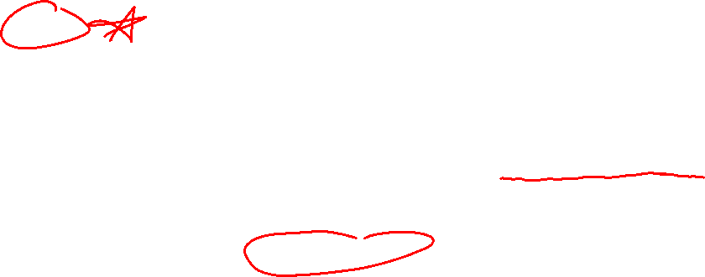
Types of Studies: Cohort
Observational study that follows a group over time:
Exclude individuals with the disease
Define cohorts by measuring exposures
Follow over time to determine incidence
Good for:
Temporal relationships
Studying multiple outcomes
Limitations:
Confounding & bias
Not always efficient (rare or long latency)
Analysis:
Relative risk
Attributable risk, population attributable risk
Notes:
Cohort studies have a TIME component
More about analyses later

Slide 19

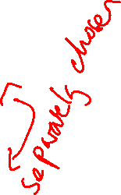
Types of Studies: Case-Control
Observational study that compares groups of individuals
Identify individuals with the condition of interest
Separately, identify another group of individuals without the condition of interest.
Work backward to determine what factors may be influencing having the condition of interest.
Group with condition “Cases”
Group without condition
“Controls”
Notes:
Choose with and without groups separately
Limit: retrospective (compare with prospective)
Odds ratio INSTEAD of relative risk

Slide 20
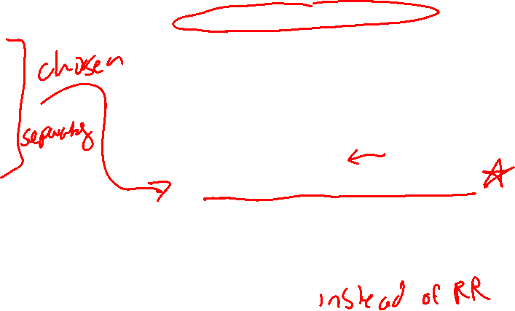

Types of Studies: Case-Control
Observational study that compares groups of individuals
Identify individuals with the condition of interest
Separately, identify another group of individuals without the condition of interest.
Work backward to determine what factors may be influencing having the condition of interest.
Good for:
Studying rare diseases
Efficiency (using few participants)
Multiple risk factors
Limitations:
Confounding & bias
Retrospective
Cannot calculate incidence
Analysis:
Cannot use Relative Risk
Odds Ratio
Notes:
Choose with and without groups separately
Limit: retrospective (compare with prospective)
Odds ratio INSTEAD of relative risk

Slide 21

Types of Studies: Randomized Trials
Experimental, prospective study to compare treatments with controls
Participants are assigned to an experimental condition (contrast with observational studies)
Good for:
Establishing cause and effect (e.g., does a treatment perform better than control?)
Limitations:
External validity issues (realism, monitored clinical environment, many exclusion criteria)

Slide 22


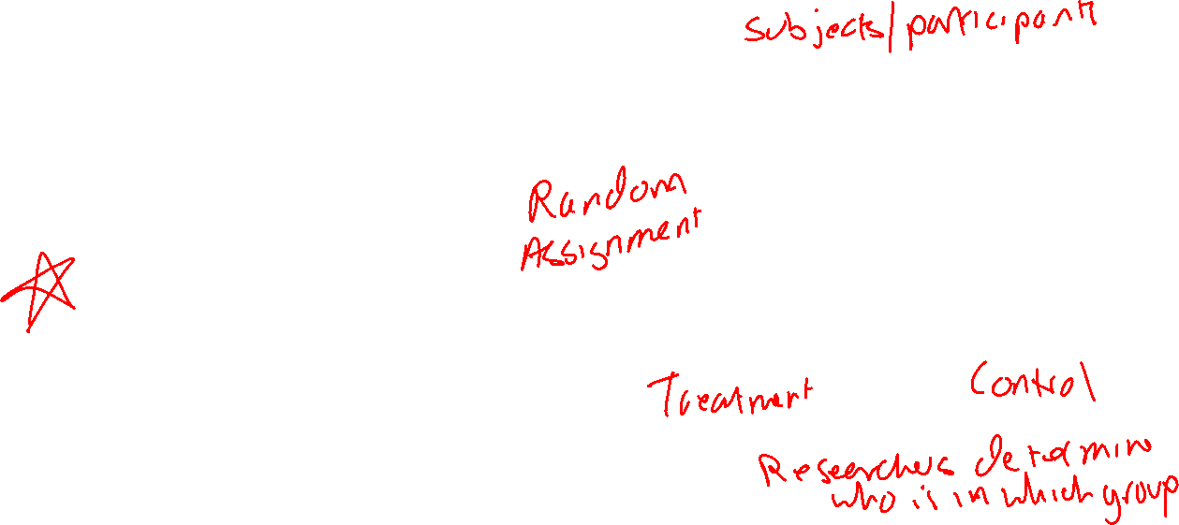
Types of Studies: Randomized Trials
Experimental, prospective study to compare treatments with controls
Participants are assigned to an experimental condition (contrast with observational studies)
Notes:
Analysis focused on group comparison (e.g., ANOVA)

Slide 23
Types of Studies: Randomized Trials
Experimental, prospective study to compare treatments with controls
Participants are assigned to an experimental condition (contrast with observational studies)
Good for:
Establishing cause and effect (e.g., does a treatment perform better than control?)
Limitations:
External validity issues (realism, monitored clinical environment, many exclusion criteria)
Notes:
Analysis focused on group comparison (e.g., ANOVA)

Slide 24
Measures of Risk

Slide 25
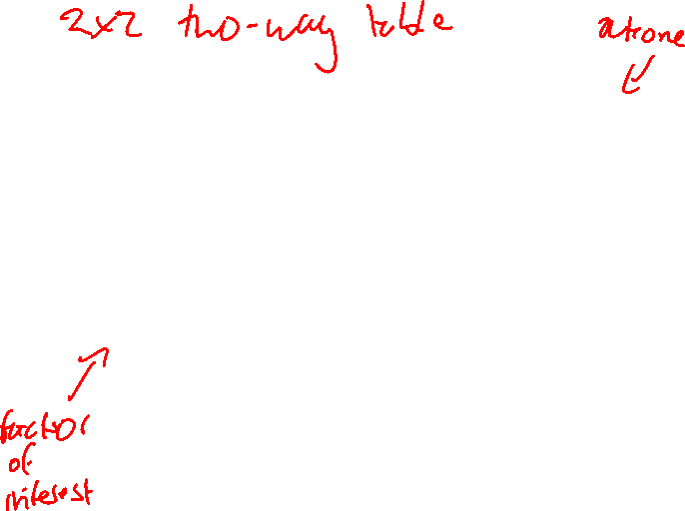
Risk
 |  | Event Occurred
 |  | Yes | No
Group | Treatment | a | b
 | Control | c | d
Risk
Absolute Risk Reduction (ARR)
Number Needed to Treat (NNT)
Number Needed to Harm (NNH)
Relative Risk (RR)
Relative Risk Reduction (RRR)
Odds Ratio (OR)
These labels are arbitrary. Often exposed/unexposed is used. There is no firm rule about which variable is rows and which is columns. A description of the data and study design is key.
Notes:
2 x 2 table with calculations of relative risk (RR) and odds ratio (OR). Contributed by Steven Tenny, MD, MPH, MBA
https://www.ncbi.nlm.nih.gov/books/NBK430824/figure/article-28324.image.f1/?report=objectonly

Slide 26
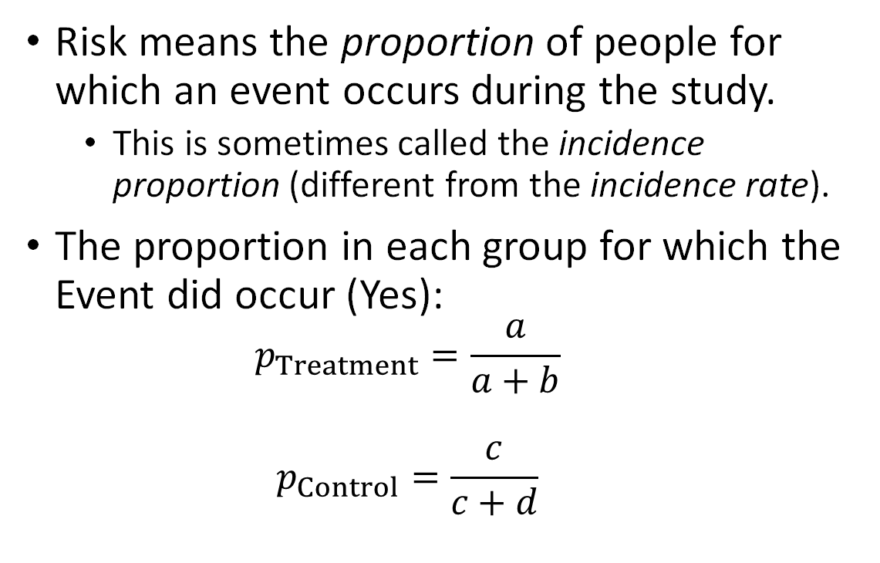
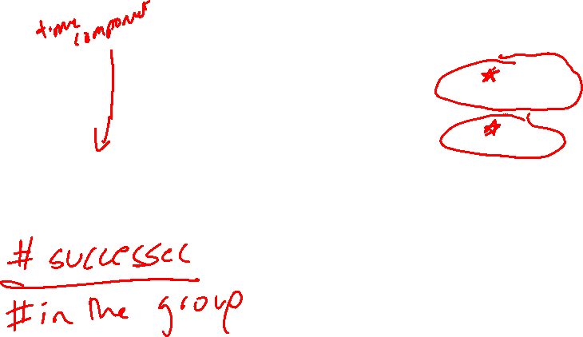
Risk
 |  | Event Occurred
 |  | Yes | No
Group | Treatment | a | b
 | Control | c | d
Risk means the proportion of people for which an event occurs during the study.
This is sometimes called the incidence proportion (different from the incidence rate).
The proportion in each group for which the Event did occur (Yes):
$$p_{Treatment}=\frac{a}{a+b}$$
$$p_{Control}=\frac{c}{c+d}$$

Slide 27
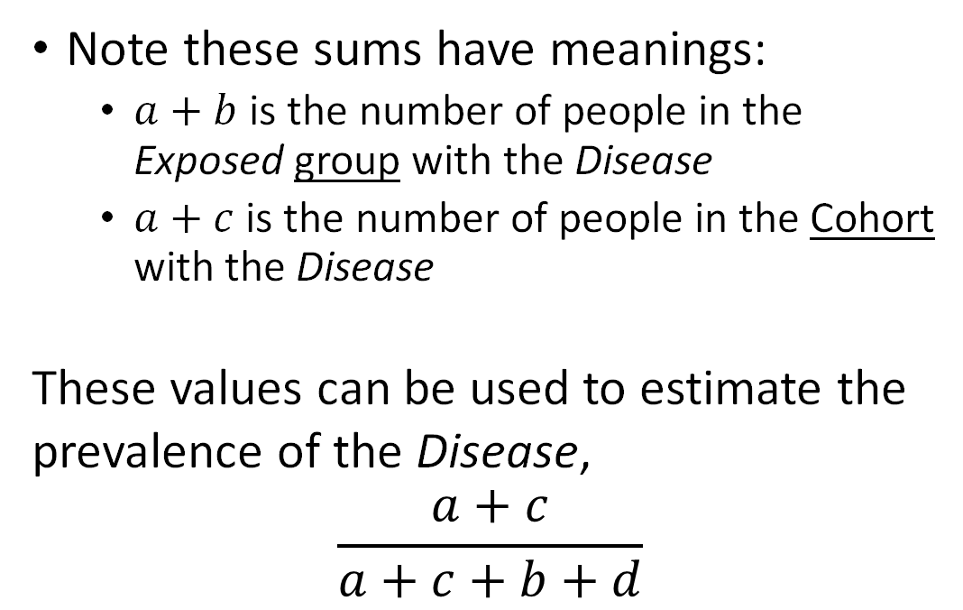

Risk and Study Design
 |  | Status
 |  | Disease | Not
Group | Exposed | a | b
 | Unexposed | c | d
Note that the study design is deeply connected to the types of analyses that can be done with a 2x2 table.
Example: In a Cohort Study, the Exposed group and Unexposed group belong to a single cohort. The cohort is followed to determine Status.
Note these sums have meanings:
$a+b$ is the number of people in the Exposed group with the Disease
$a+c$ is the number of people in the Cohort with the Disease
These values can be used to estimate the prevalence of the Disease,
$$\frac{a+c}{a+c+b+d}$$
Notes:
In a Cohort study, everyone begins in the SAME group.

Slide 28
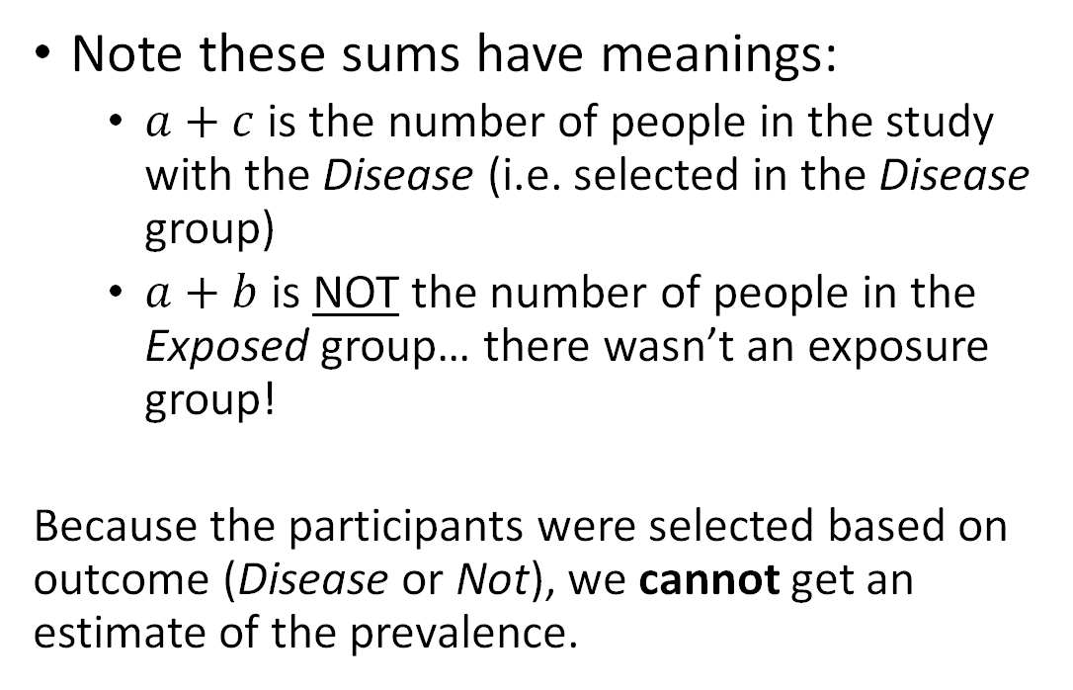
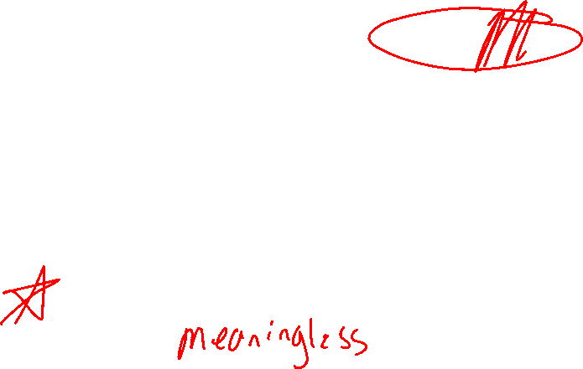
Risk and Study Design
 | Status
 | Disease | Not
Exposed | a | b
Unexposed | c | d
Note that the study design is deeply connected to the types of analyses that can be done with a 2x2 table.
Example: In a Case Control Study, participants are recruited because they have the Disease and or because they do Not it.
Note these sums have meanings:
$a+c$ is the number of people in the study with the Disease (i.e. selected in the Disease group)
$a+b$ is NOT the number of people in the Exposed group… there wasn’t an exposure group!
Because the participants were selected based on outcome (Disease or Not), we cannot get an estimate of the prevalence.
Notes:
We do not choose the exposed group!
a+b has no meaning!

Slide 29
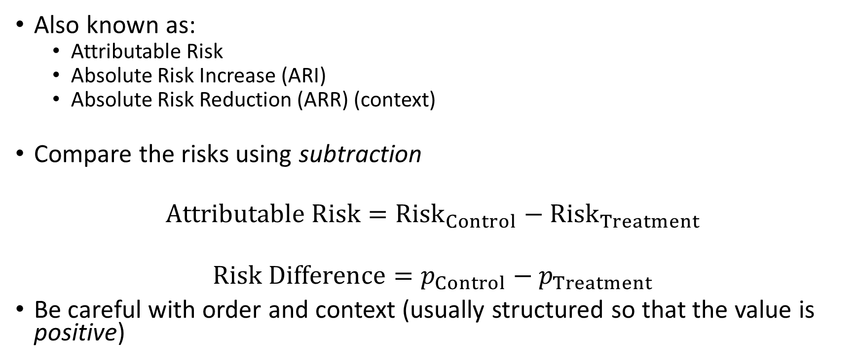


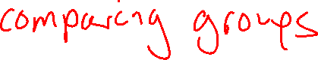
Risk Difference
 |  | Event Occurred
 |  | Yes | No
Group | Treatment | a | b
 | Control | c | d
Also known as:
Attributable Risk
Absolute Risk Increase (ARI)
Absolute Risk Reduction (ARR) (context)
Compare the risks using subtraction
$$Attributable Risk={Risk}_{Control}−{Risk}_{Treatment}$$
$$Risk Difference=p_{Control}−p_{Treatment}$$
Be careful with order and context (usually structured so that the value is positive)

Slide 30
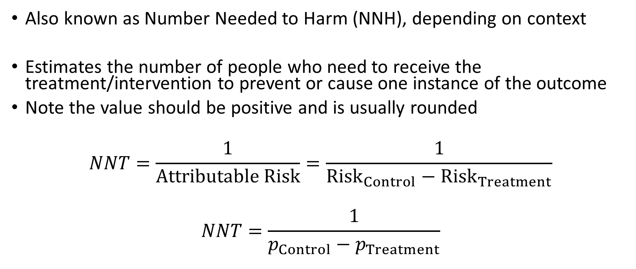
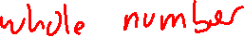
Number Needed to Treat (NNT)
Also known as Number Needed to Harm (NNH), depending on context
Estimates the number of people who need to receive the treatment/intervention to prevent or cause one instance of the outcome
Note the value should be positive and is usually rounded
$$NNT=\frac{1}{Attributable Risk}=\frac{1}{{Risk}_{Control}−{Risk}_{Treatment}}$$
$$NNT=\frac{1}{p_{Control}−p_{Treatment}}$$

Slide 31

Example (Neoplasms)
A recent study examined the Surveillance, Epidemiology, and End Results (SEER) database to examine the occurrence of myeloid neoplasms (MN) among breast cancer survivors who had received radiotherapy (RT) and who did not receive chemotherapy. Excerpts from the journal article and questions follow.
Zeidan AM, Long JB, Wang R, et al. Risk of myeloid neoplasms after radiotherapy among older women with localized breast cancer: A population-based study. Hills RK, ed. PLOS ONE. 2017;12(9):e0184747. doi:10.1371/journal.pone.0184747

Slide 32
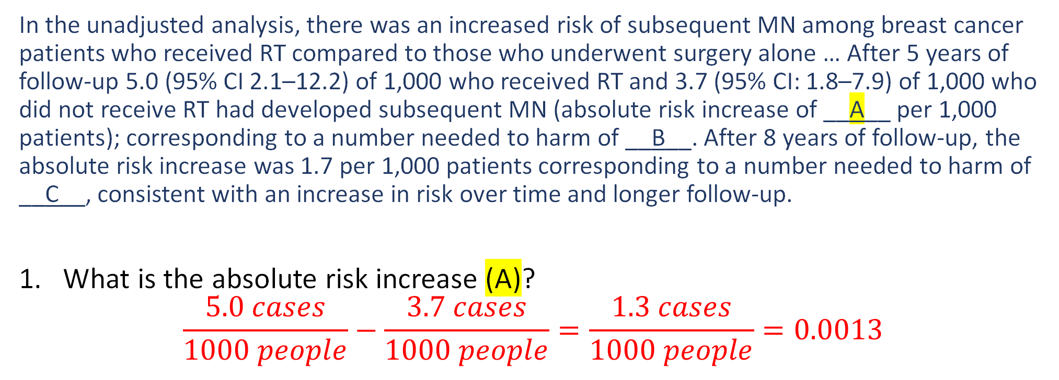
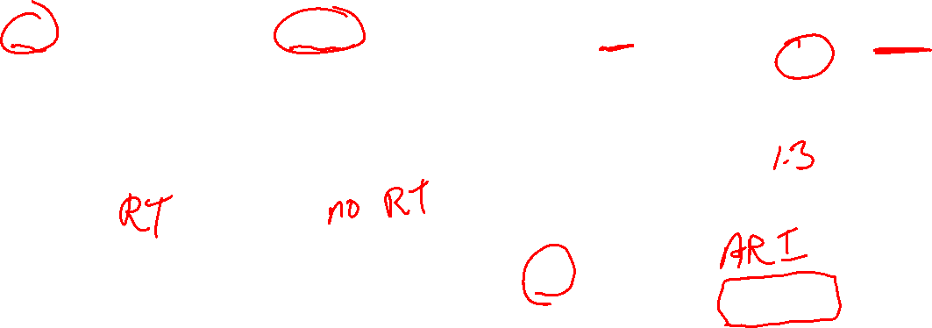
Example (Neoplasms)
In the unadjusted analysis, there was an increased risk of subsequent MN among breast cancer patients who received RT compared to those who underwent surgery alone … After 5 years of follow-up 5.0 (95% CI 2.1–12.2) of 1,000 who received RT and 3.7 (95% CI: 1.8–7.9) of 1,000 who did not receive RT had developed subsequent MN (absolute risk increase of __A__ per 1,000 patients); corresponding to a number needed to harm of __B__. After 8 years of follow-up, the absolute risk increase was 1.7 per 1,000 patients corresponding to a number needed to harm of __C__, consistent with an increase in risk over time and longer follow-up.
What is the absolute risk increase (A)? $\frac{5.0 cases}{1000 people}−\frac{3.7 cases}{1000 people}=\frac{1.3 cases}{1000 people}=0.0013$
C
C
C
Zeidan AM, Long JB, Wang R, et al. Risk of myeloid neoplasms after radiotherapy among older women with localized breast cancer: A population-based study. Hills RK, ed. PLOS ONE. 2017;12(9):e0184747. doi:10.1371/journal.pone.0184747
Notes:
$$\frac{5.0 cases}{1000 people}−\frac{3.7 cases}{1000 people}=\frac{1.3 cases}{1000 people}=0.0013$$

Slide 33
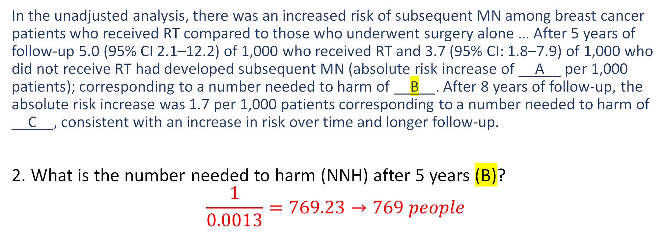
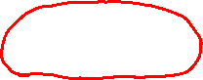
Example (Neoplasms)
In the unadjusted analysis, there was an increased risk of subsequent MN among breast cancer patients who received RT compared to those who underwent surgery alone … After 5 years of follow-up 5.0 (95% CI 2.1–12.2) of 1,000 who received RT and 3.7 (95% CI: 1.8–7.9) of 1,000 who did not receive RT had developed subsequent MN (absolute risk increase of __A__ per 1,000 patients); corresponding to a number needed to harm of __B__. After 8 years of follow-up, the absolute risk increase was 1.7 per 1,000 patients corresponding to a number needed to harm of __C__, consistent with an increase in risk over time and longer follow-up.
2. What is the number needed to harm (NNH) after 5 years (B)? $$\frac{1}{0.0013}=769.23→769 people$$
C
C
C
Zeidan AM, Long JB, Wang R, et al. Risk of myeloid neoplasms after radiotherapy among older women with localized breast cancer: A population-based study. Hills RK, ed. PLOS ONE. 2017;12(9):e0184747. doi:10.1371/journal.pone.0184747
Notes:
$$\frac{1}{0.0013}=769.23→769 people$$

Slide 34
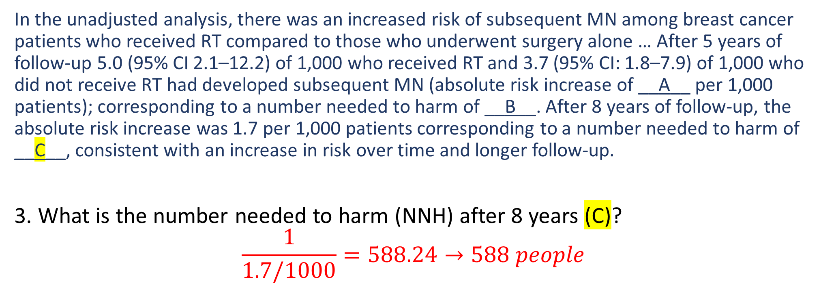
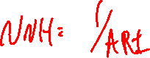
Example (Neoplasms)
In the unadjusted analysis, there was an increased risk of subsequent MN among breast cancer patients who received RT compared to those who underwent surgery alone … After 5 years of follow-up 5.0 (95% CI 2.1–12.2) of 1,000 who received RT and 3.7 (95% CI: 1.8–7.9) of 1,000 who did not receive RT had developed subsequent MN (absolute risk increase of __A__ per 1,000 patients); corresponding to a number needed to harm of __B__. After 8 years of follow-up, the absolute risk increase was 1.7 per 1,000 patients corresponding to a number needed to harm of __C__, consistent with an increase in risk over time and longer follow-up.
3. What is the number needed to harm (NNH) after 8 years (C)? $$\frac{1}{1.7/1000}=588.24→588 people$$
C
C
C
Zeidan AM, Long JB, Wang R, et al. Risk of myeloid neoplasms after radiotherapy among older women with localized breast cancer: A population-based study. Hills RK, ed. PLOS ONE. 2017;12(9):e0184747. doi:10.1371/journal.pone.0184747
Notes:
$$\frac{1}{1.7/1000}=588.24→588 people$$

Slide 35
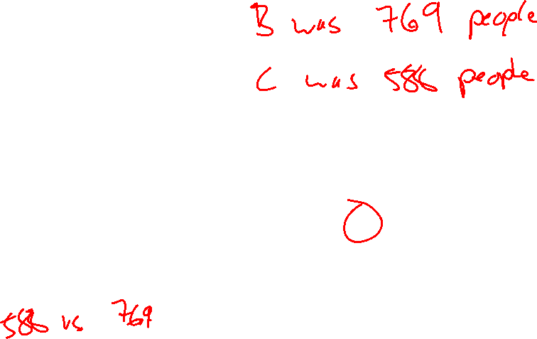
Example (Neoplasms)
In the unadjusted analysis, there was an increased risk of subsequent MN among breast cancer patients who received RT compared to those who underwent surgery alone … After 5 years of follow-up 5.0 (95% CI 2.1–12.2) of 1,000 who received RT and 3.7 (95% CI: 1.8–7.9) of 1,000 who did not receive RT had developed subsequent MN (absolute risk increase of __A__ per 1,000 patients); corresponding to a number needed to harm of __B__. After 8 years of follow-up, the absolute risk increase was 1.7 per 1,000 patients corresponding to a number needed to harm of __C__, consistent with an increase in risk over time and longer follow-up.
4. Explain why a lower value for #3 represents an increase in risk.
Fewer patients need to receive RT (588 vs. 769) to result in an additional MN case.
C
Zeidan AM, Long JB, Wang R, et al. Risk of myeloid neoplasms after radiotherapy among older women with localized breast cancer: A population-based study. Hills RK, ed. PLOS ONE. 2017;12(9):e0184747. doi:10.1371/journal.pone.0184747
Notes:
588 vs. 769
Fewer patients need to receive RT (588 vs. 769) to result in an additional MN case.

Slide 36
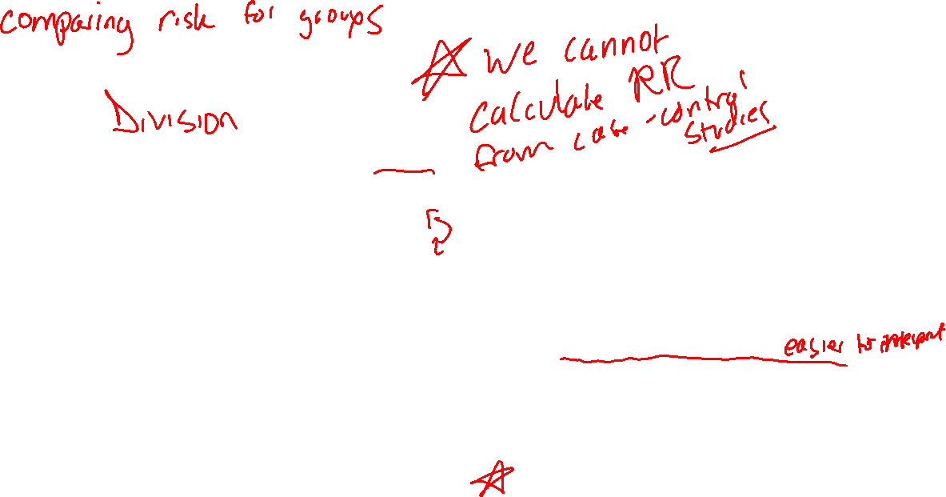
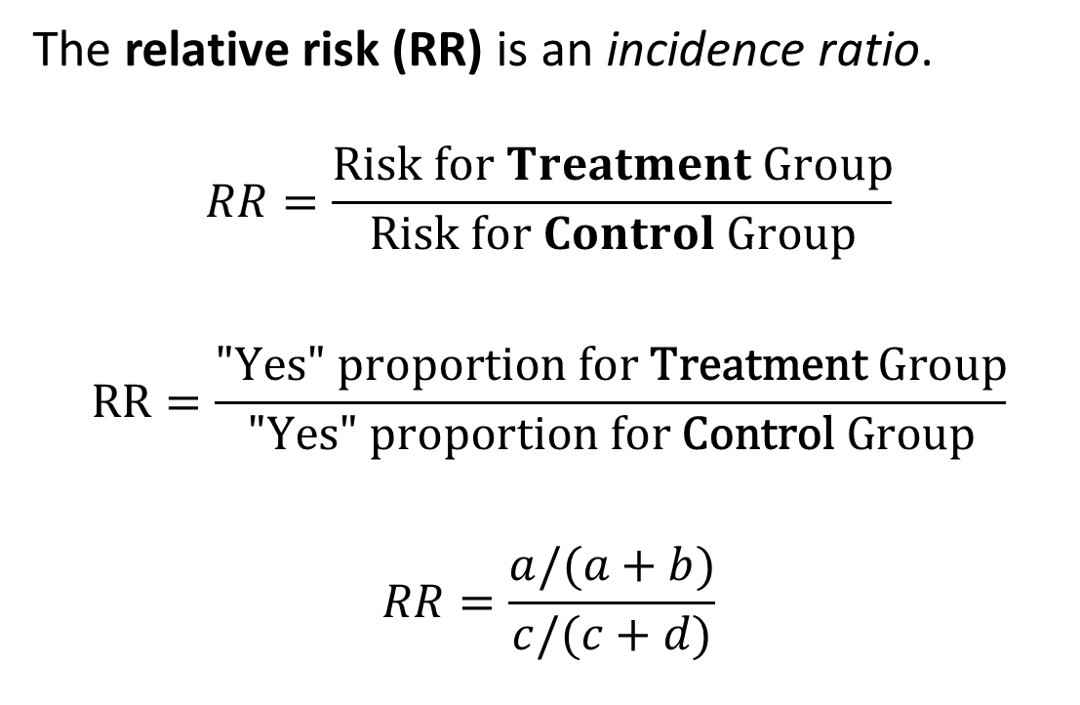

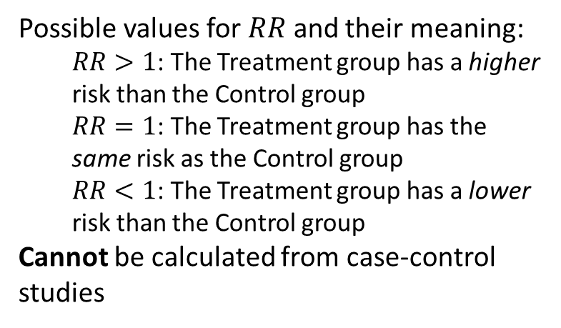
Relative Risk
 |  | Event Occurred
 |  | Yes | No
Group | Treatment | a | b
 | Control | c | d
The relative risk (RR) is an incidence ratio.
$$RR=\frac{Risk for Treatment Group}{Risk for Control Group}$$
$$RR=\frac{\text{"}\text{Yes}\text{" }\text{proportion} \text{for} \text{Treatment} \text{Group}}{\text{"}\text{Yes}\text{" }\text{proportion} \text{for} \text{Control} \text{Group}}$$
$$RR=\frac{a/(a+b)}{c/(c+d)}$$
Possible values for $RR$ and their meaning:
$RR>1$: The Treatment group has a higher risk than the Control group
$RR=1$: The Treatment group has the same risk as the Control group
$RR<1$: The Treatment group has a lower risk than the Control group
Cannot be calculated from case-control studies
Notes:
Emphasize that RR cannot be calculated from case-control studies!

Slide 37
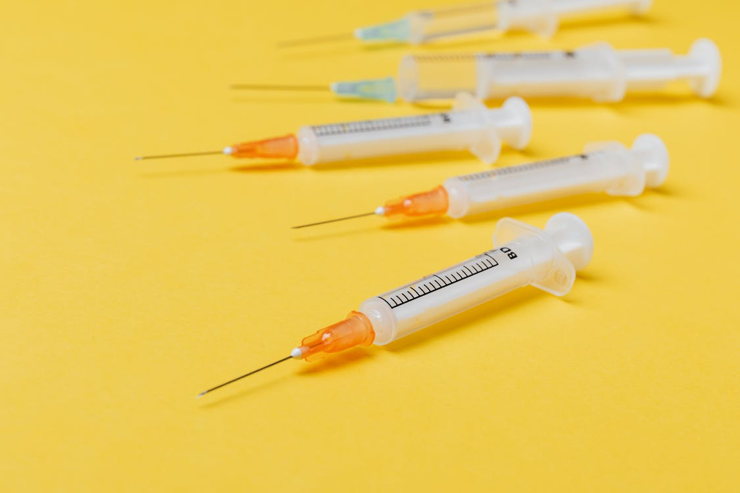
Relative Risk
A study of patients presenting GeoSentinel clinics following rabies exposure for rabies post-exposure provalaxis (RPEP) examined the relationship between receiving rabies immunoglobin (RIG) and where RPEP was started (in country of exposure or not). (Gautret et al., 2018)
 |  | RIG given in country of exposure
 |  | Yes | No
Country of Exposure | Thailand | 43 | 44
 | Other | 78 | 139
 |  | RIG given in country of exposure
 |  | Yes | No
Country of Exposure | Indonesia | 5 | 82
 | Other | 42 | 175

Slide 38
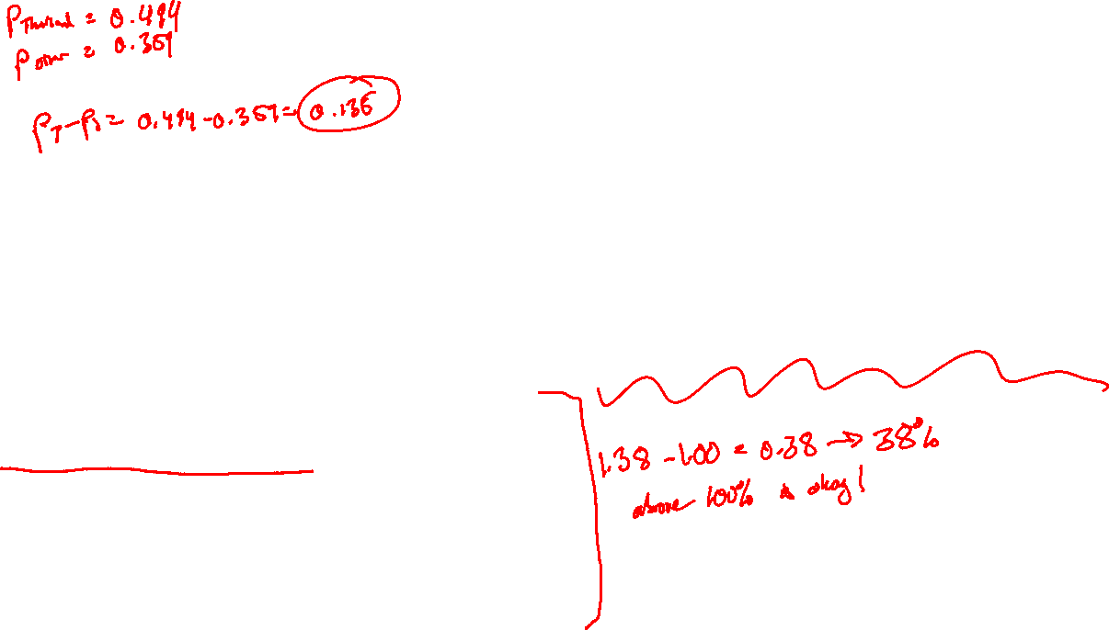
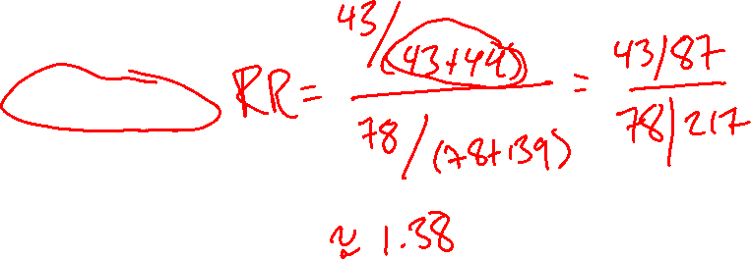
Relative Risk
 |  | RIG given in country of exposure
 |  | Yes | No
Country of Exposure | Thailand | 43 | 44
 | Other | 78 | 139
The relative risk for receiving RIG in the country of exposure for Thailand is 1.38. Reasonable interpretations of 1.38 include:
Exposure to rabies in Thailand is associated with 1.38 times greater chance of receiving RIG compared with exposure in other countries.
Exposure to rabies in Thailand is associated with a 38% greater chance of receiving RIG compared with exposure in other countries.
Notes:
$$RR=\frac{43/(43+44)}{78/(78+139)}=\frac{43/87}{78/217}≈1.38$$
38%: this the amount above 1
1.38 – 1.00 = 0.38 -> 38%

Slide 39
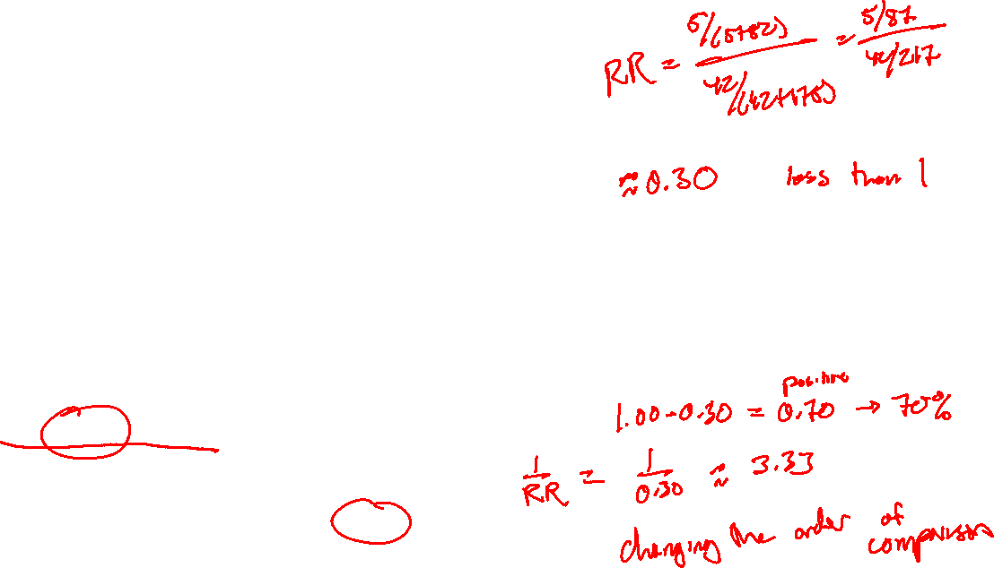
Relative Risk
 |  | RIG given in country of exposure
 |  | Yes | No
Country of Exposure | Indonesia | 5 | 82
 | Other | 42 | 175
The relative risk for receiving RIG in the country of exposure for Indonesia is 0.30. Reasonable interpretations of 0.30 include:
Exposure to rabies in Indonesia is associated with a 70% lower chance of receiving RIG compared with exposure in other countries.
Exposure to rabies in a country other than Indonesia is associated with a 3.33 times greater chance of receiving RIG compared with exposure in Indonesia.
Notes:
$$RR=\frac{5/\left(5+82\right)}{42/\left(42+175\right)}=\frac{5/87}{42/217}≈0.30$$
1.00 – 0.30 = 0.70, therefore 70% lower chance
Change the order of comparison to use the reciprocal!
1/.30 = 3.33

Slide 40
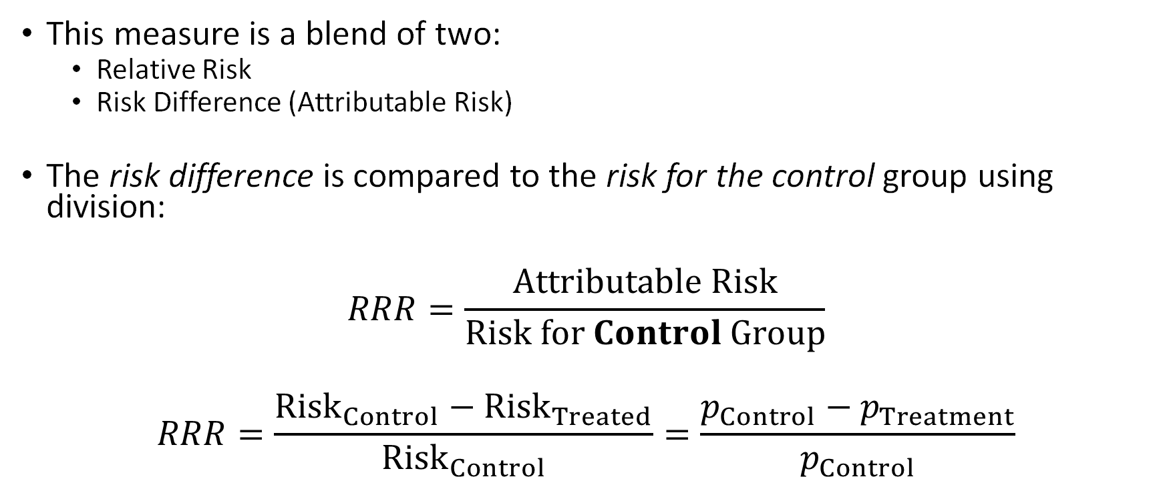
Relative Risk Reduction (RRR)
This measure is a blend of two:
Relative Risk
Risk Difference (Attributable Risk)
The risk difference is compared to the risk for the control group using division:
$$RRR=\frac{Attributable Risk}{Risk for Control Group}$$
$$RRR=\frac{{Risk}_{Control}−{Risk}_{Treated}}{{Risk}_{Control}}=\frac{p_{Control}−p_{Treatment}}{p_{Control}}$$
Notes:
Relative means Division

Slide 41
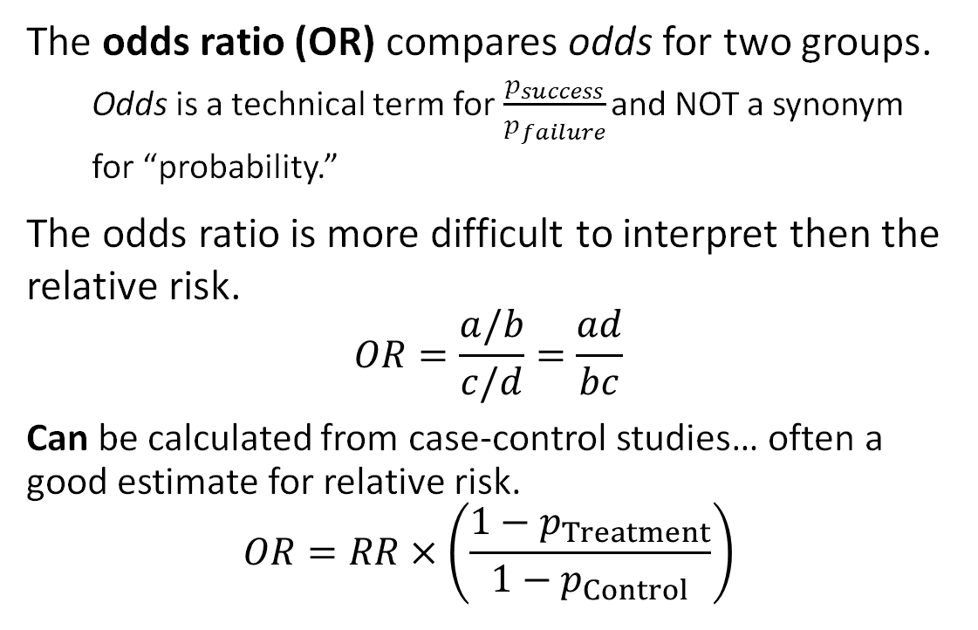
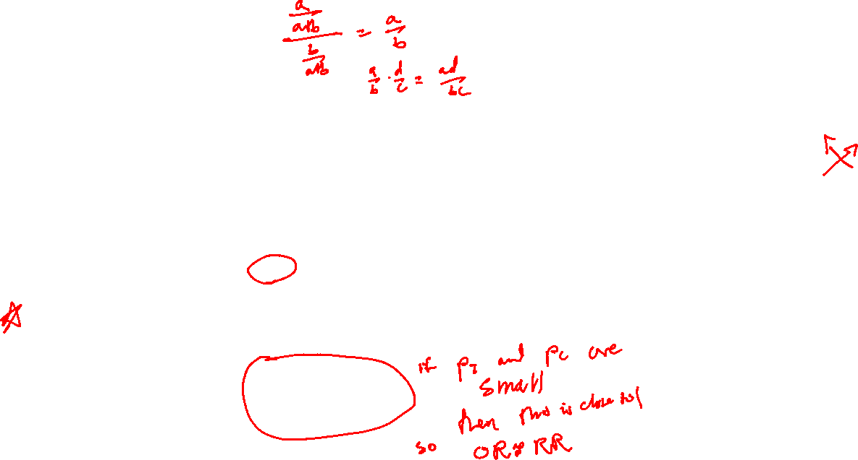
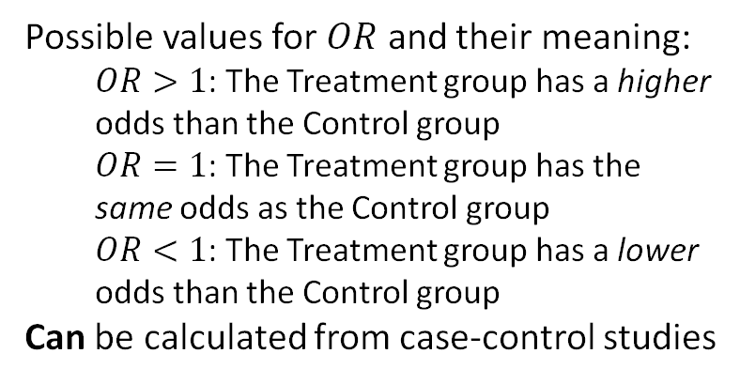
Odds Ratio
 |  | Event Occurred
 |  | Yes | No
Group | Treatment | a | b
 | Control | c | d
The odds ratio (OR) compares odds for two groups.
Odds is a technical term for $\frac{p_{success}}{p_{failure}}$ and NOT a synonym for “probability.”
The odds ratio is more difficult to interpret then the relative risk.
$$OR=\frac{a/b}{c/d}=\frac{ad}{bc}$$
Can be calculated from case-control studies… often a good estimate for relative risk.
$$OR=RR×\left(\frac{1−p_{Treatment}}{1−p_{Control}}\right)$$
Possible values for $OR$ and their meaning:
$OR>1$: The Treatment group has a higher odds than the Control group
$OR=1$: The Treatment group has the same odds as the Control group
$OR<1$: The Treatment group has a lower odds than the Control group
Can be calculated from case-control studies
Notes:
If $\frac{1−p_{Treatment}}{1−p_{Control}}$ is small, then $OR≈RR$
(Use algebra to simplify OR formula, which reveals cross-multiplying)
Emphasize that this CAN be calculated from case-control studies

Slide 42
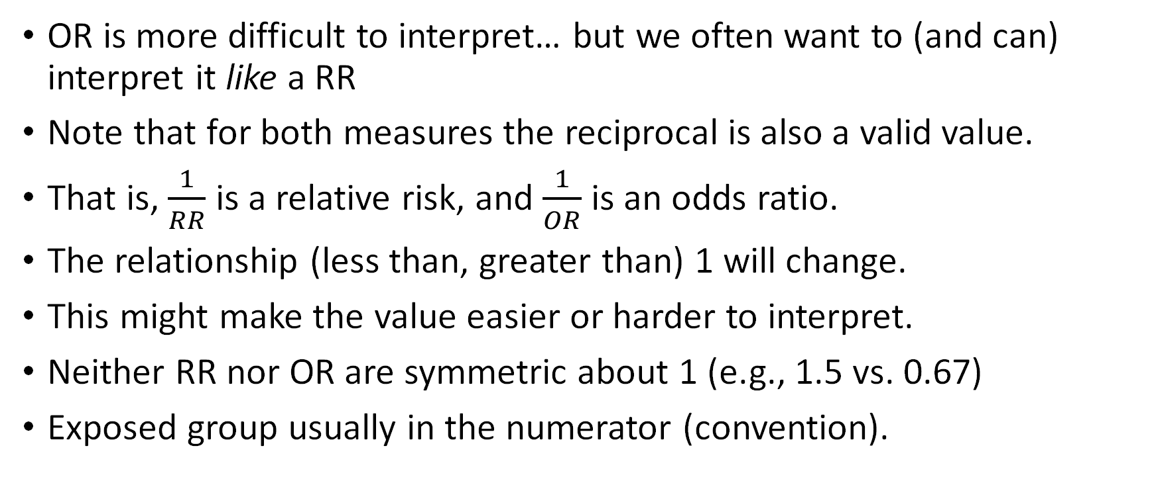
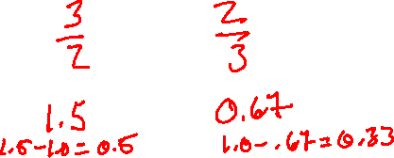
Relative Risk and Odds Ratio
OR is more difficult to interpret… but we often want to (and can) interpret it like a RR
Note that for both measures the reciprocal is also a valid value.
That is, $\frac{1}{RR}$ is a relative risk, and $\frac{1}{OR}$ is an odds ratio.
The relationship (less than, greater than) 1 will change.
This might make the value easier or harder to interpret.
Neither RR nor OR are symmetric about 1 (e.g., 1.5 vs. 0.67)
Exposed group usually in the numerator (convention).
Notes:
1.5 is 3/2
0/67 is 2/3
Both ratios using the same values but
1.5 – 1.0 = 0.5
1.0 – 0.67 = 0.33
Different distances from 1

Slide 43
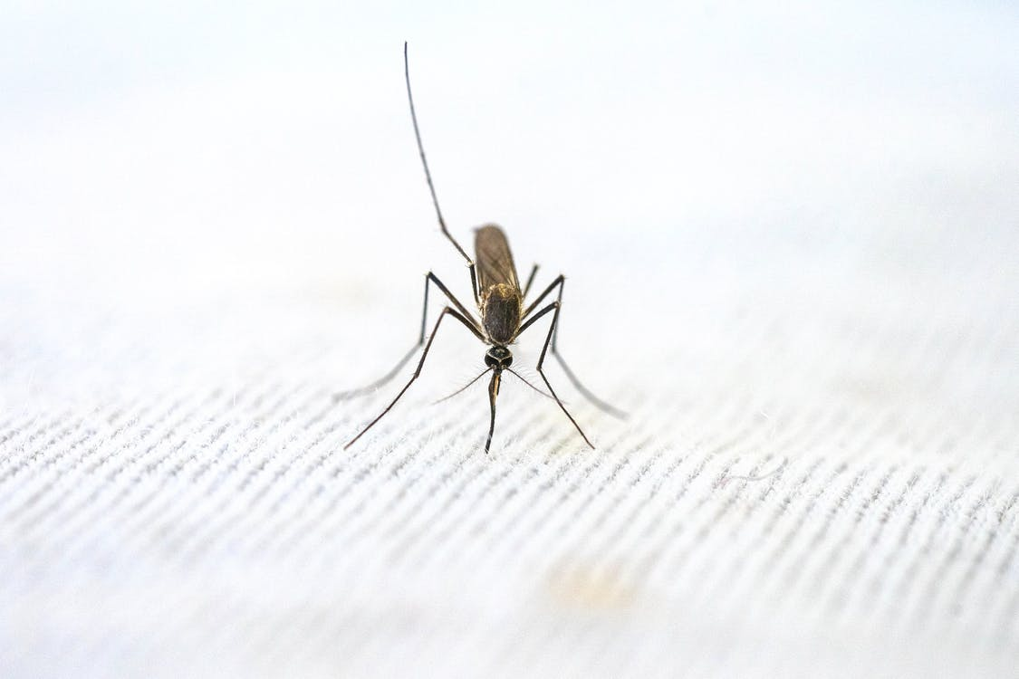

Example (Malaria)
A prospective cohort study sought to determine the association between P. vivax and severe malaria (SM). Data from this study are reproduced below and are accompanied by questions.
Can prevalence be calculated using these data? Why or why not?
Yes, it is a cohort study.
 |  | Severe Malaria?
 |  | Yes | No
Age | 0 to < 2 years | 173 | 846
 | 2 to < 5 years | 207 | 2216
Genton B, D’Acremont V, Rare L, et al. Plasmodium vivax and Mixed Infections Are Associated with Severe Malaria in Children: A Prospective Cohort Study from Papua New Guinea. Rogerson S, ed. PLoS Med. 2008;5(6):e127. doi:10.1371/journal.pmed.0050127
Notes:
Yes, it is a cohort study.

Slide 44
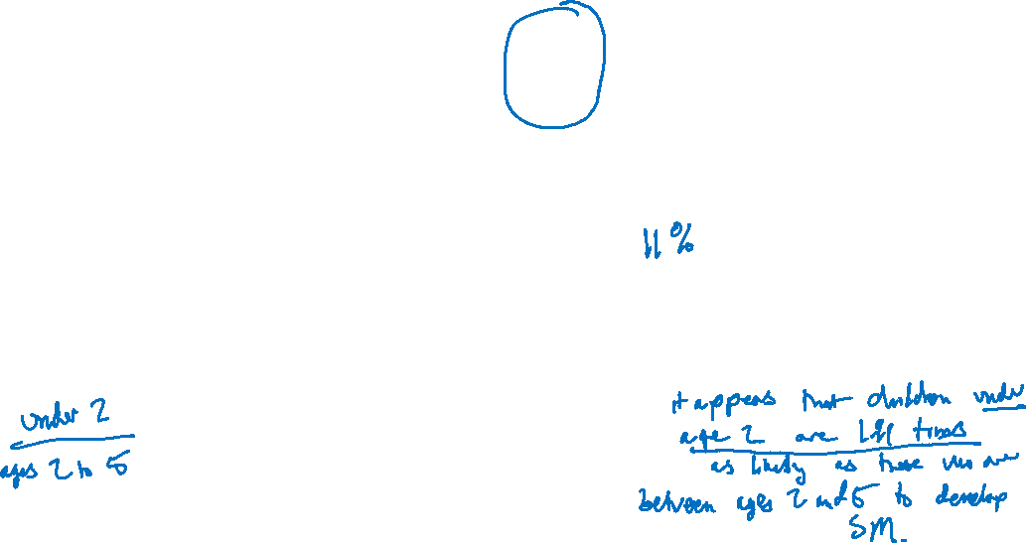
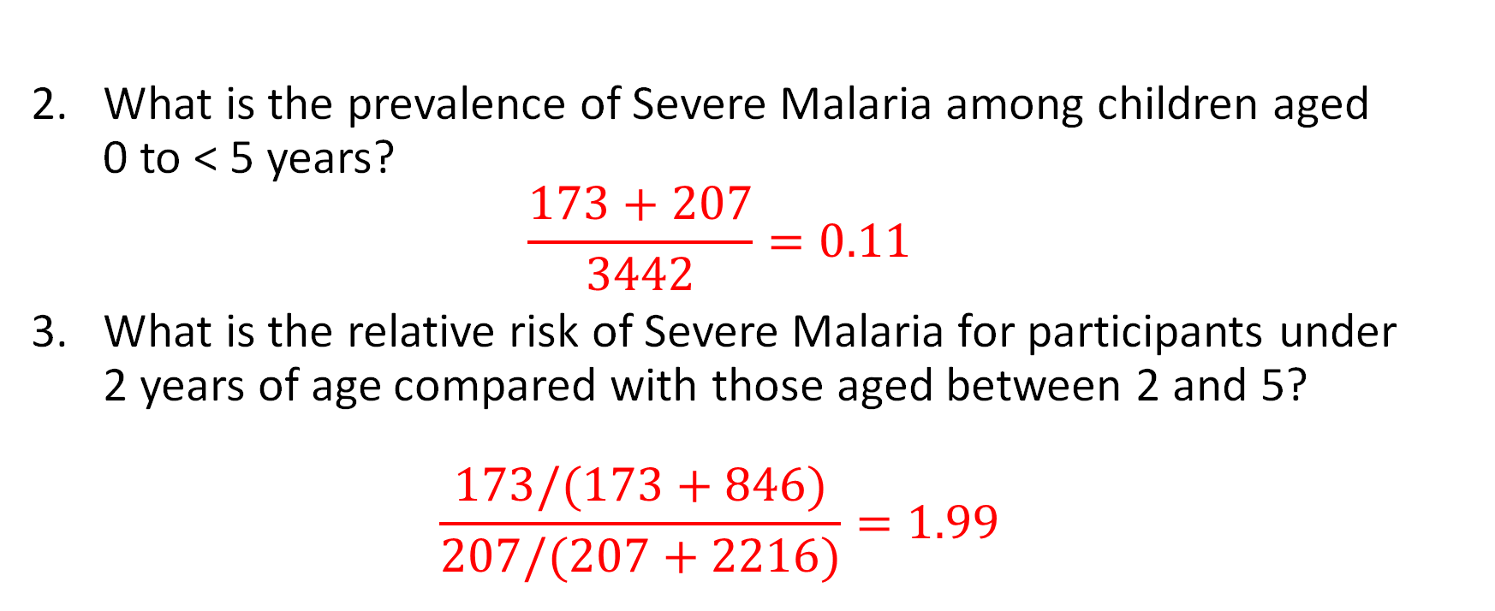
Example (Malaria)
 |  | Severe Malaria?
 |  | Yes | No
Age | 0 to < 2 years | 173 | 846
 | 2 to < 5 years | 207 | 2216
What is the prevalence of Severe Malaria among children aged 0 to < 5 years? $\frac{173+207}{3442}=0.11$
What is the relative risk of Severe Malaria for participants under 2 years of age compared with those aged between 2 and 5? $\frac{173/(173+846)}{207/(207+2216)}=1.99$
Genton B, D’Acremont V, Rare L, et al. Plasmodium vivax and Mixed Infections Are Associated with Severe Malaria in Children: A Prospective Cohort Study from Papua New Guinea. Rogerson S, ed. PLoS Med. 2008;5(6):e127. doi:10.1371/journal.pmed.0050127
Notes:
Give table total: 3442
Circle 173 and 207 (numerator)
What is the prevalence of Severe Malaria among children aged 0 to < 5 years? $\frac{173+207}{3442}=0.11$
What is the relative risk of Severe Malaria for participants under 2 years of age compared with those aged between 2 and 5? $\frac{173/(173+846)}{207/(207+2216)}=1.99$

Slide 45

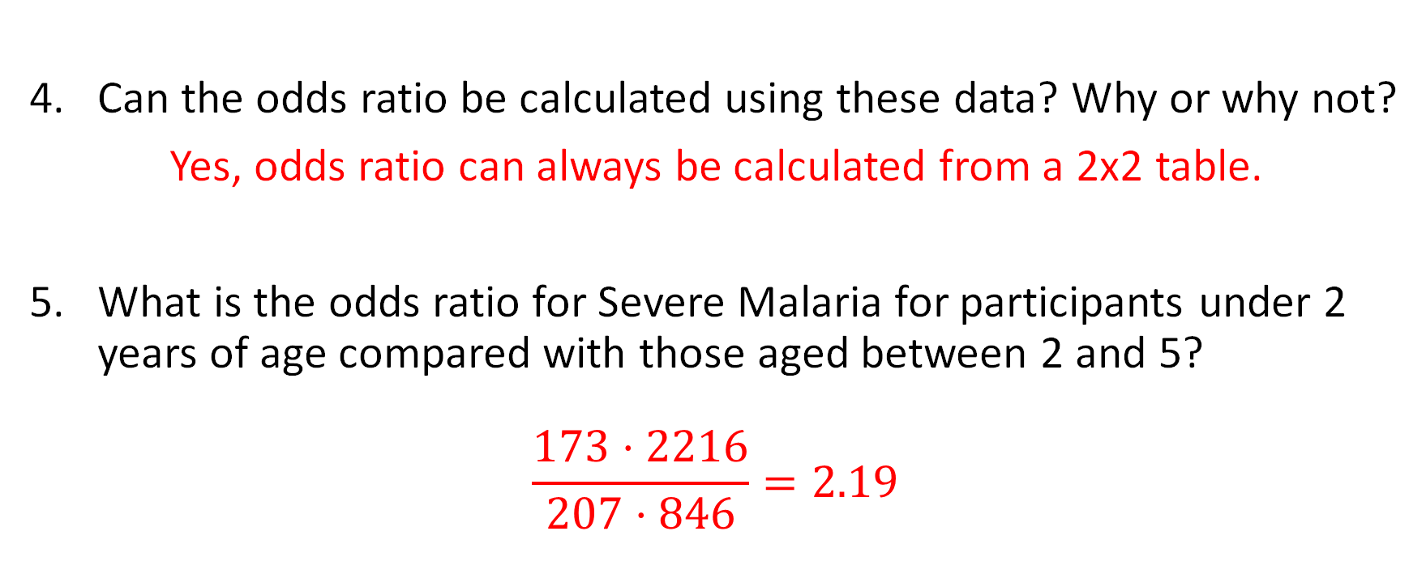
Example (Malaria)
 |  | Severe Malaria?
 |  | Yes | No
Age | 0 to < 2 years | 173 | 846
 | 2 to < 5 years | 207 | 2216
Can the odds ratio be calculated using these data? Why or why not?
Yes, odds ratio can always be calculated from a 2x2 table.
What is the odds ratio for Severe Malaria for participants under 2 years of age compared with those aged between 2 and 5?
$$\frac{173⋅2216}{207⋅846}=2.19$$
Genton B, D’Acremont V, Rare L, et al. Plasmodium vivax and Mixed Infections Are Associated with Severe Malaria in Children: A Prospective Cohort Study from Papua New Guinea. Rogerson S, ed. PLoS Med. 2008;5(6):e127. doi:10.1371/journal.pmed.0050127
Notes:
Can the odds ratio be calculated using these data? Why or why not?
Yes, odds ratio can always be calculated from a 2x2 table.
What is the odds ratio for Severe Malaria for participants under 2 years of age compared with those aged between 2 and 5?
$$\frac{173⋅2216}{207⋅846}=2.19$$

Slide 46

Example (Malaria)
 |  | Severe Malaria?
 |  | Yes | No
Age | 0 to < 2 years | 173 | 846
 | 2 to < 5 years | 207 | 2216
Compare the relative risk to the odds ratio.
1.99 vs. 2.19. They are similar values.
Genton B, D’Acremont V, Rare L, et al. Plasmodium vivax and Mixed Infections Are Associated with Severe Malaria in Children: A Prospective Cohort Study from Papua New Guinea. Rogerson S, ed. PLoS Med. 2008;5(6):e127. doi:10.1371/journal.pmed.0050127
Notes:
What is the odds ratio for Severe Malaria for participants under 2 years of age compared with those aged between 2 and 5?
$$\frac{173⋅2216}{207⋅846}=2.19$$
Compare the relative risk to the odds ratio.
1.99 vs. 2.19. They are similar values.

Slide 47
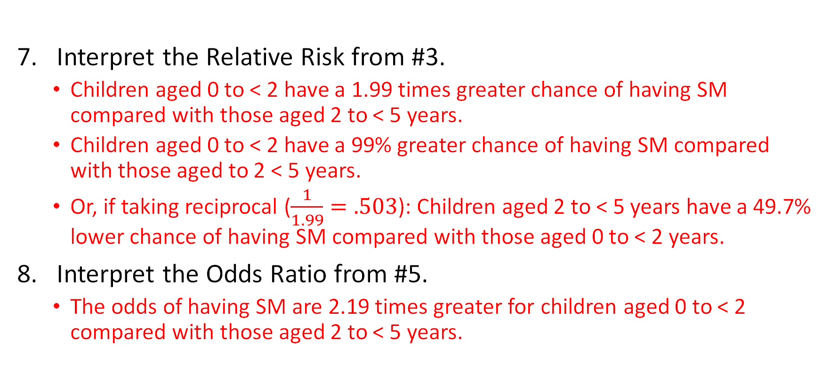
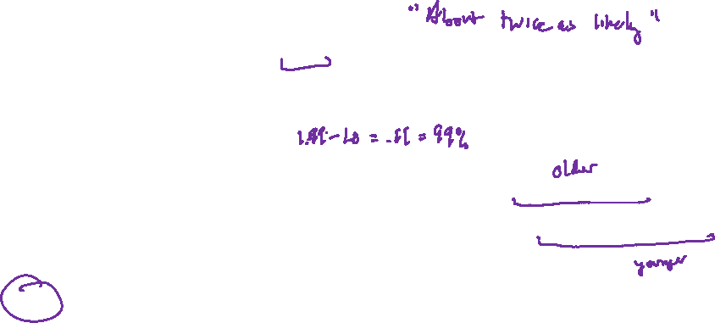
Example (Malaria)
 |  | Severe Malaria?
 |  | Yes | No
Age | 0 to < 2 years | 173 | 846
 | 2 to < 5 years | 207 | 2216
Interpret the Relative Risk from #3.
Children aged 0 to < 2 have a 1.99 times greater chance of having SM compared with those aged 2 to < 5 years.
Children aged 0 to < 2 have a 99% greater chance of having SM compared with those aged to 2 < 5 years.
Or, if taking reciprocal ($\frac{1}{1.99}=.503$): Children aged 2 to < 5 years have a 49.7% lower chance of having SM compared with those aged 0 to < 2 years.
Interpret the Odds Ratio from #5.
The odds of having SM are 2.19 times greater for children aged 0 to < 2 compared with those aged 2 to < 5 years.
Genton B, D’Acremont V, Rare L, et al. Plasmodium vivax and Mixed Infections Are Associated with Severe Malaria in Children: A Prospective Cohort Study from Papua New Guinea. Rogerson S, ed. PLoS Med. 2008;5(6):e127. doi:10.1371/journal.pmed.0050127
Notes:
Interpret the Relative Risk from #3.
Children aged 0 to < 2 have a 1.99 times greater chance of having SM compared with those aged 2 to < 5 years.
“About a two times greater chance”
Children aged 0 to < 2 have a 99% greater chance of having SM compared with those aged to 2 < 5 years.
Or, if taking reciprocal ($\frac{1}{1.99}=.503$): Children aged 2 to < 5 years have a 49.7% lower chance of having SM compared with those aged 0 to < 2 years.
1 – 0.503 = 0.497, so 39.7%
Interpret the Odds Ratio from #5.
The odds of having SM are 2.19 times greater for children aged 0 to < 2 compared with those aged 2 to < 5 years.
Note that the RR and OR interpretations are similar!

Slide 48
Statistical Inference

Slide 49

Statistical Inference
Notes:
https://www.pexels.com/photo/bird-s-eye-view-of-group-of-people-1299086/

Slide 50
Statistical Inference
Statistical Inference
Use data from a small group (sample) …
… to draw conclusions about a larger group (population).
Notes:
https://www.pexels.com/photo/bird-s-eye-view-of-group-of-people-1299086/

Slide 51
Statistical Inference
Two major approaches:
Hypothesis testing (p-values)
“Which of two descriptions of the population is better-supported by the data?”
Confidence Intervals (CIs)
“Based on the data, what are plausible values for an unknown population value?”
Underlying logic of statistical inference is sophisticated and subtle – be careful when reporting/documenting statistics (see NHST)

Slide 52


Hypothesis Testing
Null hypothesis ($H_{0}$): usually “no effect” (or equivalent)
Alternative hypothesis ($H_{A}$): usually “there is some effect”
Critical idea:
We assume that the null hypothesis is true and collect evidence against it.
If we collect enough evidence against the null hypothesis to think it is wrong…
Then we think the alternative hypothesis is a better description of reality.
We do NOT accept or prove the null hypothesis true.
At best we “fail to reject” the null hypothesis.

Slide 53

Hypothesis Testing
A p-value quantifies the strength of the evidence against the null hypothesis.
A p-value answers this question:
If the null hypothesis is true,
what is the probability
we would observe a test statistic as extreme
(or more extreme)
than the test statistic we actually did observe?

Slide 54

Hypothesis Testing
A p-value quantifies the strength of the evidence against the null hypothesis.
A p-value answers this question:
If the null hypothesis is true, what is the probability we would observe a test statistic as extreme (or more extreme) than the test statistic we actually did observe?
A small p-value is strong evidence against the null hypothesis.
A BIG p-value is weak evidence against the null hypothesis.
Caution: This feels counterintuitive to many people at first.

Slide 55

Interpreting p-values
Very little evidence against the null hypothesis
0.10
Weak evidence against the null hypothesis
0.05
Moderate evidence against the null hypothesis
0.025
Strong evidence against the null hypothesis
0.001
Very strong evidence against the null hypothesis
Notes:
Essentially no evidence against
Borderline
(Moderate)
Substantial
Overwhelming

Slide 56


Hypothesis Testing
A study compared healthcare costs for patients prescribed a High Dose of gabapentin to those prescribed a Low Dose. (Fleet et al., 2018)
If there was really no difference in average cost for Emergency Visits, the probability we would see an average difference of $13.41 (or greater) is less than 0.0001.
Notes:
$H_{0}:$ There is NO difference in average cost between high and low dose patients
$H_{A}:$ There IS a difference in average cost between high and low dose patients

Slide 57

Hypothesis Testing
A study compared healthcare costs for patients prescribed a High Dose of gabapentin to those prescribed a Low Dose. (Fleet et al., 2018)
Because the p-value is so small (less than 0.0001), there is overwhelming evidence that there is some difference in average cost for Emergency Visits between High Dose and Low Dose patients.
Notes:
The p-value gives NO INFORMATION on the size of the effect!!!

Slide 58


Hypothesis Testing
Consider this excerpt of Table 3 from the rabies study earlier (Gautret et al., 2018)
For which countries is there strong evidence that the RR is not equal to 1?
Notes:
$$H_{0}:RR=1$$
$$H_{A}:RR≠1$$

Slide 59
Contemporary Views of p-values
The new guidelines discuss many aspects of the reporting of studies in [The New England Journal of Medicine], including a requirement to replace P values with estimates of effects or association and 95% confidence intervals when neither the protocol nor the statistical analysis plan has specified methods used to adjust for multiplicity. Journal editors and statistical consultants have become increasingly concerned about the overuse and misinterpretation of significance testing and P values in the medical literature. Along with their strengths, P values are subject to inherent weaknesses… (Harrington et al., 2019) [emphasis added]
Harrington, D., D’Agostino, R. B., Gatsonis, C., Hogan, J. W., Hunter, D. J., Normand, S.-L. T., Drazen, J. M., & Hamel, M. B. (2019). New Guidelines for Statistical Reporting in the Journal. New England Journal of Medicine, 381(3), 285–286. https://doi.org/10.1056/NEJMe1906559

Slide 60
Contemporary Views of p-values
In view of the prevalent misuses of and misconceptions concerning p‑values, some statisticians prefer to supplement or even replace p‑values with other approaches. These include methods that emphasize estimation over testing, such as confidence, credibility, or prediction intervals; Bayesian methods; alternative measures of evidence, such as likelihood ratios or Bayes Factors; and other approaches such as decision-theoretic modeling and false discovery rates. All these measures and approaches rely on further assumptions, but they may more directly address the size of an effect (and its associated uncertainty) or whether the hypothesis is correct. (Wasserstein et al., 2016, p. 132) [emphasis added]
Wasserstein, R. L., & Lazar, N. A. (2016). The ASA Statement on p -Values: Context, Process, and Purpose. The American Statistician, 70(2), 129–133. https://doi.org/10.1080/00031305.2016.1154108
Notes:
Emphasize 2016 date
American Statistical Association

Slide 61

Contemporary Views of p-values
P-values can indicate how incompatible the data are with a specified statistical model.
P-values do not measure the probability that the studied hypothesis is true, or the probability that the data were produced by random chance alone.
Scientific conclusions and business or policy decisions should not be based only on whether a p-value passes a specific threshold.
Proper inference requires full reporting and transparency.
A p-value, or statistical significance, does not measure the size of an effect or the importance of a result.
By itself, a p-value does not provide a good measure of evidence regarding a model or hypothesis. (Wasserstein et al., 2016, pp. 131-132)
Wasserstein, R. L., & Lazar, N. A. (2016). The ASA Statement on p -Values: Context, Process, and Purpose. The American Statistician, 70(2), 129–133. https://doi.org/10.1080/00031305.2016.1154108
Notes:
Emphasize #5

Slide 62

Contemporary Views of p-values
The ASA Statement on P-Values and Statistical Significance stopped just short of recommending that declarations of “statistical significance” be abandoned. We take that step here. We conclude, based on our review of the articles in this special issue and the broader literature, that it is time to stop using the term “statistically significant” entirely. Nor should variants such as “significantly different,” “p < 0.05,” and “nonsignificant” survive, whether expressed in words, by asterisks in a table, or in some other way. (Wasserstein et al., 2019, p. 2) [emphasis added]
Wasserstein, R. L., Schirm, A. L., & Lazar, N. A. (2019). Moving to a World Beyond “ p < 0.05.” The American Statistician, 73(sup1), 1–19. https://doi.org/10.1080/00031305.2019.1583913
Notes:
Emphasize 2019 date
NHST Critique
Null
Hypothesis
Significance
Testing

Slide 63


Type I and Type II Errors
If we reject $H_{0}$ when $H_{0}$ is true, we have committed a Type I error.
If we fail to reject $H_{0}$ when $H_{0}$ is false, we have committed a Type II error.
 |  | Truth about the population
 |  | H₀ true | H₀ false (H_{a} true)
Conclusion based on sample | Reject H₀ | Type I error | Correct conclusion
 | Fail to reject H₀ | Correct conclusion | Type II error

Slide 64


Type I and Type II Errors (Criminal Trial)
If we reject $H_{0}$ when $H_{0}$ is true, we have committed a Type I error.
If we fail to reject $H_{0}$ when $H_{0}$ is false, we have committed a Type II error.
 |  | Actual Truth
 |  | Innocent H₀ true | Committed Crime H₀ false (H_{a} true)
Conclusion of trial | “Guilty” Reject H₀ | Type I error | Correct conclusion
 | “Not Guilty” Fail to reject H₀ | Correct conclusion | Type II error
C
C
C
C

Slide 65

Type I and Type II Errors (Criminal Trial)
How can we reduce the chances that we send an innocent person to jail?
How can we lower the chances of a Type I Error?
What are the consequences of this?
 |  | Actual Truth
 |  | Innocent H₀ true | Committed Crime H₀ false (H_{a} true)
Conclusion of trial | “Guilty” Reject H₀ | Type I error | Correct conclusion
 | “Not Guilty” Fail to reject H₀ | Correct conclusion | Type II error

Slide 66

Type I and Type II Errors (Criminal Trial)
How can we reduce the chances that we let a guilty person go free?
How can we lower the chances of a Type II Error?
What are the consequences of this?
 |  | Actual Truth
 |  | Innocent H₀ true | Committed Crime H₀ false (H_{a} true)
Conclusion of trial | “Guilty” Reject H₀ | Type I error | Correct conclusion
 | “Not Guilty” Fail to reject H₀ | Correct conclusion | Type II error
Notes:
Parks and Recreation Season 2 Episode 5 “Sister City”

Slide 67

Type I and Type II Errors
Replication studies and meta-analyses are important
Importance of Type I & Type II Errors strongly depend on context
Need to know statistical hypotheses (may not be explicitly written, but usually standard – consult references)
Power is the ability to correctly reject the null hypothesis
$$Power=1−P(Type II Error)$$

Slide 68

Confidence Intervals
Provide an interval of values that are all plausible for a true, unknown population value based on the data.
A confidence level is specified (often 95%).
Want to be more confident (e.g., 95% -> 99%)?
Interval gets wider.
Want a narrower (more precise) interval?
Lower confidence level (e.g., 95% -> 90%).
Notes:
Any value in a confidence interval is (equally) plausible.
As n ↑ width ↓ (at the same confidence level)

Slide 69
Confidence Intervals
The confidence level (e.g., 95%) is a statement about the confidence in the method and not a statement of confidence about the specific interval calculated!
That is, if you commit to making 95% confidence intervals over and over and over, about 95% of them will contain the true (unknown) value you want to identify.
And therefore about 5% will not contain the true (unknown) value you want to identify. (That is, they will be wrong.)
No way of knowing which are right and which are wrong.
(Confidence in the method!)
Notes:
Emphasize first bullet

Slide 70
Confidence Intervals
Confidence Intervals can be used in a way analogous to Hypothesis Testing.
In Hypothesis Testing, there is often a single value in the null hypothesis.
Difference in values? Usually null hypothesis is “0”
Ratio of values? Usually null hypothesis is “1”
Examine the CI:
if this value is in the CI, then it is plausible…
if it is plausible, that is not evidence against the null hypothesis…
“fail to reject” the null hypothesis
If the value is not in the CI, it is not plausible, go with the alternative hypothesis
Notes:
CIs are preferred to HT today

Slide 71

Hypothesis Testing
Consider this excerpt of Table 3 from the rabies study earlier (Gautret et al., 2018)
Which countries have a RR significantly different from 1?
Notes:
Is 1 in the interval?
Point out the rounding for Thailand (1.0)

Slide 72
Diagnostic Rates
Sensitivity & Specificity

Slide 73

Sensitivity and Specificity
Screening diseases – need a gold standard
“Accuracy” of a test is not good enough
The sensitivity of a test is its ability to correctly identify patients who have the condition being tested for
Correct positives
The specificity of a test is its ability to correctly identify patients who do not have the condition being tested for
Correct negatives
Notes:
SnNOut: Sensitive, Negative, Rule Out
SpPIn: Specific, Positive, Rule In
Too simplistic!
SpPIn & SnNOut mnemonic: https://www.ncbi.nlm.nih.gov/pmc/articles/PMC487735/
Summary points
Negative results from highly sensitive tests can rule a diagnosis out (sensitive, negative, out = SnNOut), and
positive results from highly specific tests can rule a diagnosis in (specific, positive, in = SpPIn)
Studies quoted as showing SpPIn or SnNOut properties may be affected by spectrum bias, partial verification bias, or incorporation bias. Others may be too small to define test characteristics with sufficient precision
The power of a test to rule a diagnosis out does not depend exclusively on its sensitivity, as suggested by the SnNOut rule, but is reduced by low specificity. Similarly, the power to rule in depends on both specificity and sensitivity
The evidence from studies of a test's accuracy should be critically assessed, and post-test probabilities (with 95% confidence intervals) should be calculated when evaluating potential SnNOut or SpPIn tests
Assuming that a diagnosis can be ruled in or out with confidence, when in reality it cannot, could have serious consequences for patients

Slide 74


Sensitivity and Specificity
 |  | True Disease Status
 |  | Yes | No
Screening Result | Positive | TP | FP
 | Negative | FN | TN
TP = True Positive
TN = True Negative
FN = False Negative
FP = False Positive
$$Sensitivity=\frac{True Positives}{All Yes Disease}=\frac{TP}{TP+FN}$$
$$Specificity=\frac{True Negatives}{All No Disease}=\frac{TN}{TN+FP}$$
$$False Positive Error Rate=\frac{False Positives}{All No Disease}=\frac{FP}{TN+FP}$$
$$False Negative Error Rate=\frac{False Negatives}{All Yes Disease}=\frac{FN}{TP+FN}$$
The rate at which true No disease patients are incorrectly flagged Positive.
The rate at which true Yes disease patients are incorrectly flagged Negative.
Notes:
SpPIn & SnNOut mnemonic: https://www.ncbi.nlm.nih.gov/pmc/articles/PMC487735/
Summary points
Negative results from highly sensitive tests can rule a diagnosis out (sensitive, negative, out = SnNOut), and
positive results from highly specific tests can rule a diagnosis in (specific, positive, in = SpPIn)
Studies quoted as showing SpPIn or SnNOut properties may be affected by spectrum bias, partial verification bias, or incorporation bias. Others may be too small to define test characteristics with sufficient precision
The power of a test to rule a diagnosis out does not depend exclusively on its sensitivity, as suggested by the SnNOut rule, but is reduced by low specificity. Similarly, the power to rule in depends on both specificity and sensitivity
The evidence from studies of a test's accuracy should be critically assessed, and post-test probabilities (with 95% confidence intervals) should be calculated when evaluating potential SnNOut or SpPIn tests
Assuming that a diagnosis can be ruled in or out with confidence, when in reality it cannot, could have serious consequences for patients

Slide 75

Sensitivity and Specificity
 |  | True Disease Status
 |  | Yes | No
Screening Result | Positive | TP | FP
 | Negative | FN | TN
TP = True Positive
TN = True Negative
FN = False Negative
FP = False Positive
$$Positive Predictive Value(PPV)=\frac{True Positives}{All Positives}=\frac{TP}{TP+FP}$$
$$Negative Predictive Value(NPV)=\frac{True Negatives}{All Negatives}=\frac{TN}{TN+FN}$$
$$Likelihood Ratio Positive (LR+)=\frac{Sensitivity}{1−Specificity}$$
$$Likelihood Ratio Negative (LR−)=\frac{1−Sensitivity}{Specificity}$$
The proportion of patients with Positive results who Yes had the disease
The proportion of patients with Negative results who No, did not have the disease
The higher this value is, the better a test is. (Should be much larger than 1.)
The lower this value is, the better a test is. (Should be as close to 0 as possible.)
Notes:
SpPIn & SnNOut mnemonic: https://www.ncbi.nlm.nih.gov/pmc/articles/PMC487735/
Summary points
Negative results from highly sensitive tests can rule a diagnosis out (sensitive, negative, out = SnNOut), and
positive results from highly specific tests can rule a diagnosis in (specific, positive, in = SpPIn)
Studies quoted as showing SpPIn or SnNOut properties may be affected by spectrum bias, partial verification bias, or incorporation bias. Others may be too small to define test characteristics with sufficient precision
The power of a test to rule a diagnosis out does not depend exclusively on its sensitivity, as suggested by the SnNOut rule, but is reduced by low specificity. Similarly, the power to rule in depends on both specificity and sensitivity
The evidence from studies of a test's accuracy should be critically assessed, and post-test probabilities (with 95% confidence intervals) should be calculated when evaluating potential SnNOut or SpPIn tests
Assuming that a diagnosis can be ruled in or out with confidence, when in reality it cannot, could have serious consequences for patients

Slide 76


Example (Leptospirosis)
A study was conducted to evaluate the performance of a Rapid Diagnostic Test (RDT) for leptospirosis in French tropical territories. PCR was used as a gold standard to classify patients as either having Leptospirosis or being Controls. Germane results are reproduced below, and questions follow.
 |  | Leptospirosis | Control
IgM RDT assay | Positive | 168 | 14
 | Negative | 19 | 207
Goarant C, Bourhy P, D’Ortenzio E, et al. Sensitivity and Specificity of a New Vertical Flow Rapid Diagnostic Test for the Serodiagnosis of Human Leptospirosis. Büscher P, ed. PLoS Negl Trop Dis. 2013;7(6):e2289. doi:10.1371/journal.pntd.0002289

Slide 77


 |  | Leptospirosis | Control
IgM RDT assay | Positive | 168 | 14
 | Negative | 19 | 207
Sensitivity $\frac{168}{168+19}=.898$ or 89.8%
Specificity $\frac{207}{207+14}=.937$ or 93.7%
False Positive Error Rate $1−.937=.063$ or 6.3%
False Negative Error Rate $1−.898=.102$ or 10.2%
Goarant C, Bourhy P, D’Ortenzio E, et al. Sensitivity and Specificity of a New Vertical Flow Rapid Diagnostic Test for the Serodiagnosis of Human Leptospirosis. Büscher P, ed. PLoS Negl Trop Dis. 2013;7(6):e2289. doi:10.1371/journal.pntd.0002289
Notes:
Sensitivity $\frac{168}{168+19}=.898$ or 89.8%
Specificity $\frac{207}{207+14}=.937$ or 93.7%
False Positive Error Rate $1−.937=.063$ or 6.3%
False Negative Error Rate $1−.898=.102$ or 10.2%

Slide 78


 |  | Leptospirosis | Control
IgM RDT assay | Positive | 168 | 14
 | Negative | 19 | 207
Likelihood Ratio + $\frac{.898}{1−.937}=14.182$
Likelihood Ratio - $\frac{1−.898}{.937}=.108$
Positive Predictive Value $\frac{168}{168+14}=.923$ or 92.3%
Negative Predictive Value $\frac{207}{207+19}=.916$ or 91.6%
Goarant C, Bourhy P, D’Ortenzio E, et al. Sensitivity and Specificity of a New Vertical Flow Rapid Diagnostic Test for the Serodiagnosis of Human Leptospirosis. Büscher P, ed. PLoS Negl Trop Dis. 2013;7(6):e2289. doi:10.1371/journal.pntd.0002289
Notes:
Sensitivity $\frac{168}{168+19}=.898$ or 89.8%
Specificity $\frac{207}{207+14}=.937$ or 93.7%
Likelihood Ratio + $\frac{.898}{1−.937}=14.182$
Likelihood Ratio - $\frac{1−.898}{.937}=.108$
Positive Predictive Value $\frac{168}{168+14}=.923$ or 92.3%
Negative Predictive Value $\frac{207}{207+19}=.916$ or 91.6%

Slide 79
References & Credits

Slide 80
This presentation
Slides for this presentation will be made available online
A handout with additional practice problems is also online (with solutions)
https://tinyurl.com/2rbe225y
https://github.com/douglaswhitaker/public-files/tree/main/biostatistics
These files will be available at this URL for at least 6 months
(If they move before that, there will be new links at that URL to take you to them.)

Slide 81
Online Resources
The Little Handbook of Statistical Practice
StatisticalPractice.com redirects to http://www.jerrydallal.com/LHSP/LHSP.HTM
Old but good

Slide 82
References
Case, C. & Whitaker, D. (2016). Innocent until proven guilty: Exploring statistical power through simulations. Mathematics Teacher, 109(9), 686-692. https://www.jstor.org/stable/10.5951/mathteacher.109.9.0686
Harrington, D., D’Agostino, R. B., Gatsonis, C., Hogan, J. W., Hunter, D. J., Normand, S.-L. T., Drazen, J. M., & Hamel, M. B. (2019). New Guidelines for Statistical Reporting in the Journal. New England Journal of Medicine, 381(3), 285–286. https://doi.org/10.1056/NEJMe1906559
Katz DL, Elmore JG, Wild DMG, Lucan SC, eds. Jekel’s Epidemiology, Biostatistics, Preventive Medicine, and Public Health. 4th ed. Philadelphia, Pa. ; London: Saunders; 2014.
Kestenbaum B. Epidemiology and Biostatistics: An Introduction to Clinical Research. Second edition. (Weiss NS, Shoben A, eds.). Cham: Springer; 2019.
Noordzij M, Dekker FW, Zoccali C, Jager KJ. Measures of Disease Frequency: Prevalence and Incidence. Nephron Clin Pract. 2010;115(1):c17-c20. doi:10.1159/000286345
Porta MS, Greenland S, Hernán M, Silva I dos S, Last JM, International Epidemiological Association, eds. A Dictionary of Epidemiology. Six edition. Oxford: Oxford University Press; 2014.
Shapiro K, Brown SA. RxPrep Course Book: A Comprehensive Course for the NAPLEX® and CPJE. RxPrep, Inc.; 2015.

Slide 83
Studies Used in Examples
Christiansen SC, Næss IA, Cannegieter SC, Hammerstrøm J, Rosendaal FR, Reitsma PH. Inflammatory Cytokines as Risk Factors for a First Venous Thrombosis: A Prospective Population-Based Study. Greaves M, ed. PLoS Med. 2006;3(8):e334. doi:10.1371/journal.pmed.0030334
Fleet JL, Dixon SN, Kuwornu PJ, et al. Gabapentin dose and the 30-day risk of altered mental status in older adults: A retrospective population-based study. Wu P-H, ed. PLOS ONE. 2018;13(3):e0193134. doi:10.1371/journal.pone.0193134
Galappaththi-Arachchige HN, Holmen S, Koukounari A, et al. Evaluating diagnostic indicators of urogenital Schistosoma haematobium infection in young women: A cross sectional study in rural South Africa. Knight M, ed. PLOS ONE. 2018;13(2):e0191459. doi:10.1371/journal.pone.0191459
Gautret P, Angelo KM, Asgeirsson H, et al. Rabies post-exposure prophylaxis started during or after travel: A GeoSentinel analysis. Gilbert AT, ed. PLoS Negl Trop Dis. 2018;12(11):e0006951. doi:10.1371/journal.pntd.0006951
Genton B, D’Acremont V, Rare L, et al. Plasmodium vivax and Mixed Infections Are Associated with Severe Malaria in Children: A Prospective Cohort Study from Papua New Guinea. Rogerson S, ed. PLoS Med. 2008;5(6):e127. doi:10.1371/journal.pmed.0050127
Goarant C, Bourhy P, D’Ortenzio E, et al. Sensitivity and Specificity of a New Vertical Flow Rapid Diagnostic Test for the Serodiagnosis of Human Leptospirosis. Büscher P, ed. PLoS Negl Trop Dis. 2013;7(6):e2289. doi:10.1371/journal.pntd.0002289
Zeidan AM, Long JB, Wang R, et al. Risk of myeloid neoplasms after radiotherapy among older women with localized breast cancer: A population-based study. Hills RK, ed. PLOS ONE. 2017;12(9):e0184747. doi:10.1371/journal.pone.0184747

Slide 84
Art Credits
4
2
3
5
1
6
https://www.pexels.com/photo/people-gathered-watching-a-panda-mascot-2346289/
https://pixabay.com/illustrations/girl-photographer-camera-snapshot-2803516/
https://pixabay.com/vectors/association-community-group-meeting-152746/
https://pixabay.com/vectors/people-group-crowd-line-silhouette-312122/
https://pixabay.com/vectors/dice-red-two-game-rolling-chance-25637/
https://www.pexels.com/photo/two-person-doing-surgery-inside-room-1250655/
https://www.pexels.com/photo/syringe-injectors-placed-on-yellow-surface-4210559/
https://www.pexels.com/photo/close-up-view-of-mosquito-9891863/
https://www.pexels.com/photo/bird-s-eye-view-of-group-of-people-1299086/
https://www.pexels.com/photo/judges-desk-with-gavel-and-scales-5669619/
By CDC/ Rob Weyant - http://phil.cdc.gov/PHIL_Images/20050308/22ad4ce53a1648feb011a7d6dd26fbb6/138_lores.jpg, Public Domain, https://commons.wikimedia.org/w/index.php?curid=611941
7
10
8
11
9

